Slide 1
Bearsden and Milngavie
Ramblers and Hillwalkers
A thematic collection of group’s activities as seen through the lens of
Peter Bartos’ camera from 2006 to 2021
Part 6

Slide 2
Part 6
The photographers

Slide 3
Almost everyone takes
photos
on our walks,
there are prize-winning
photographers amongst us

Slide 4
The photographers cover a wide variety of
subjects,
accordingly, they may be grouped as:

Slide 5
Panoramists ?

Slide 6
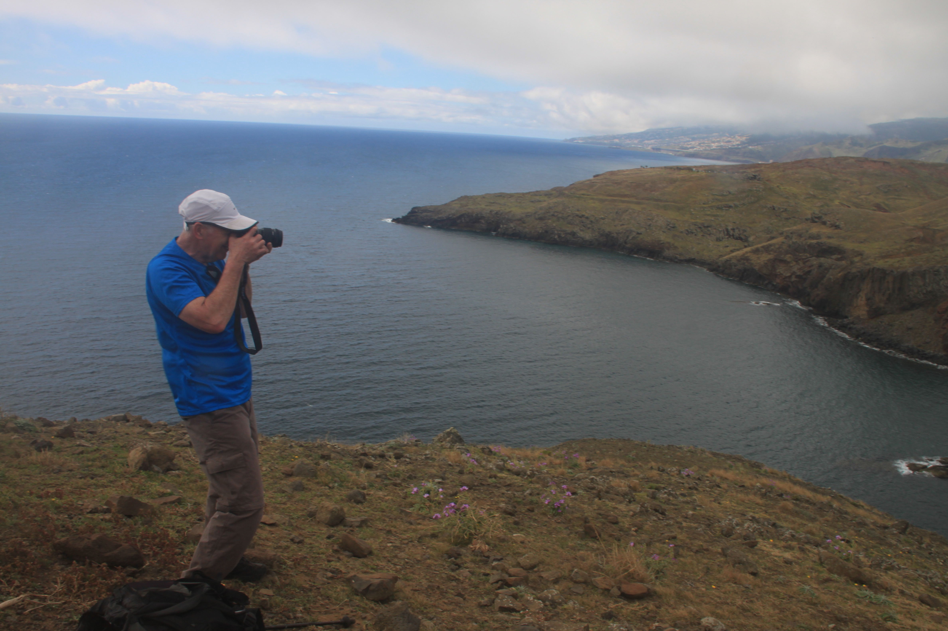

Slide 7
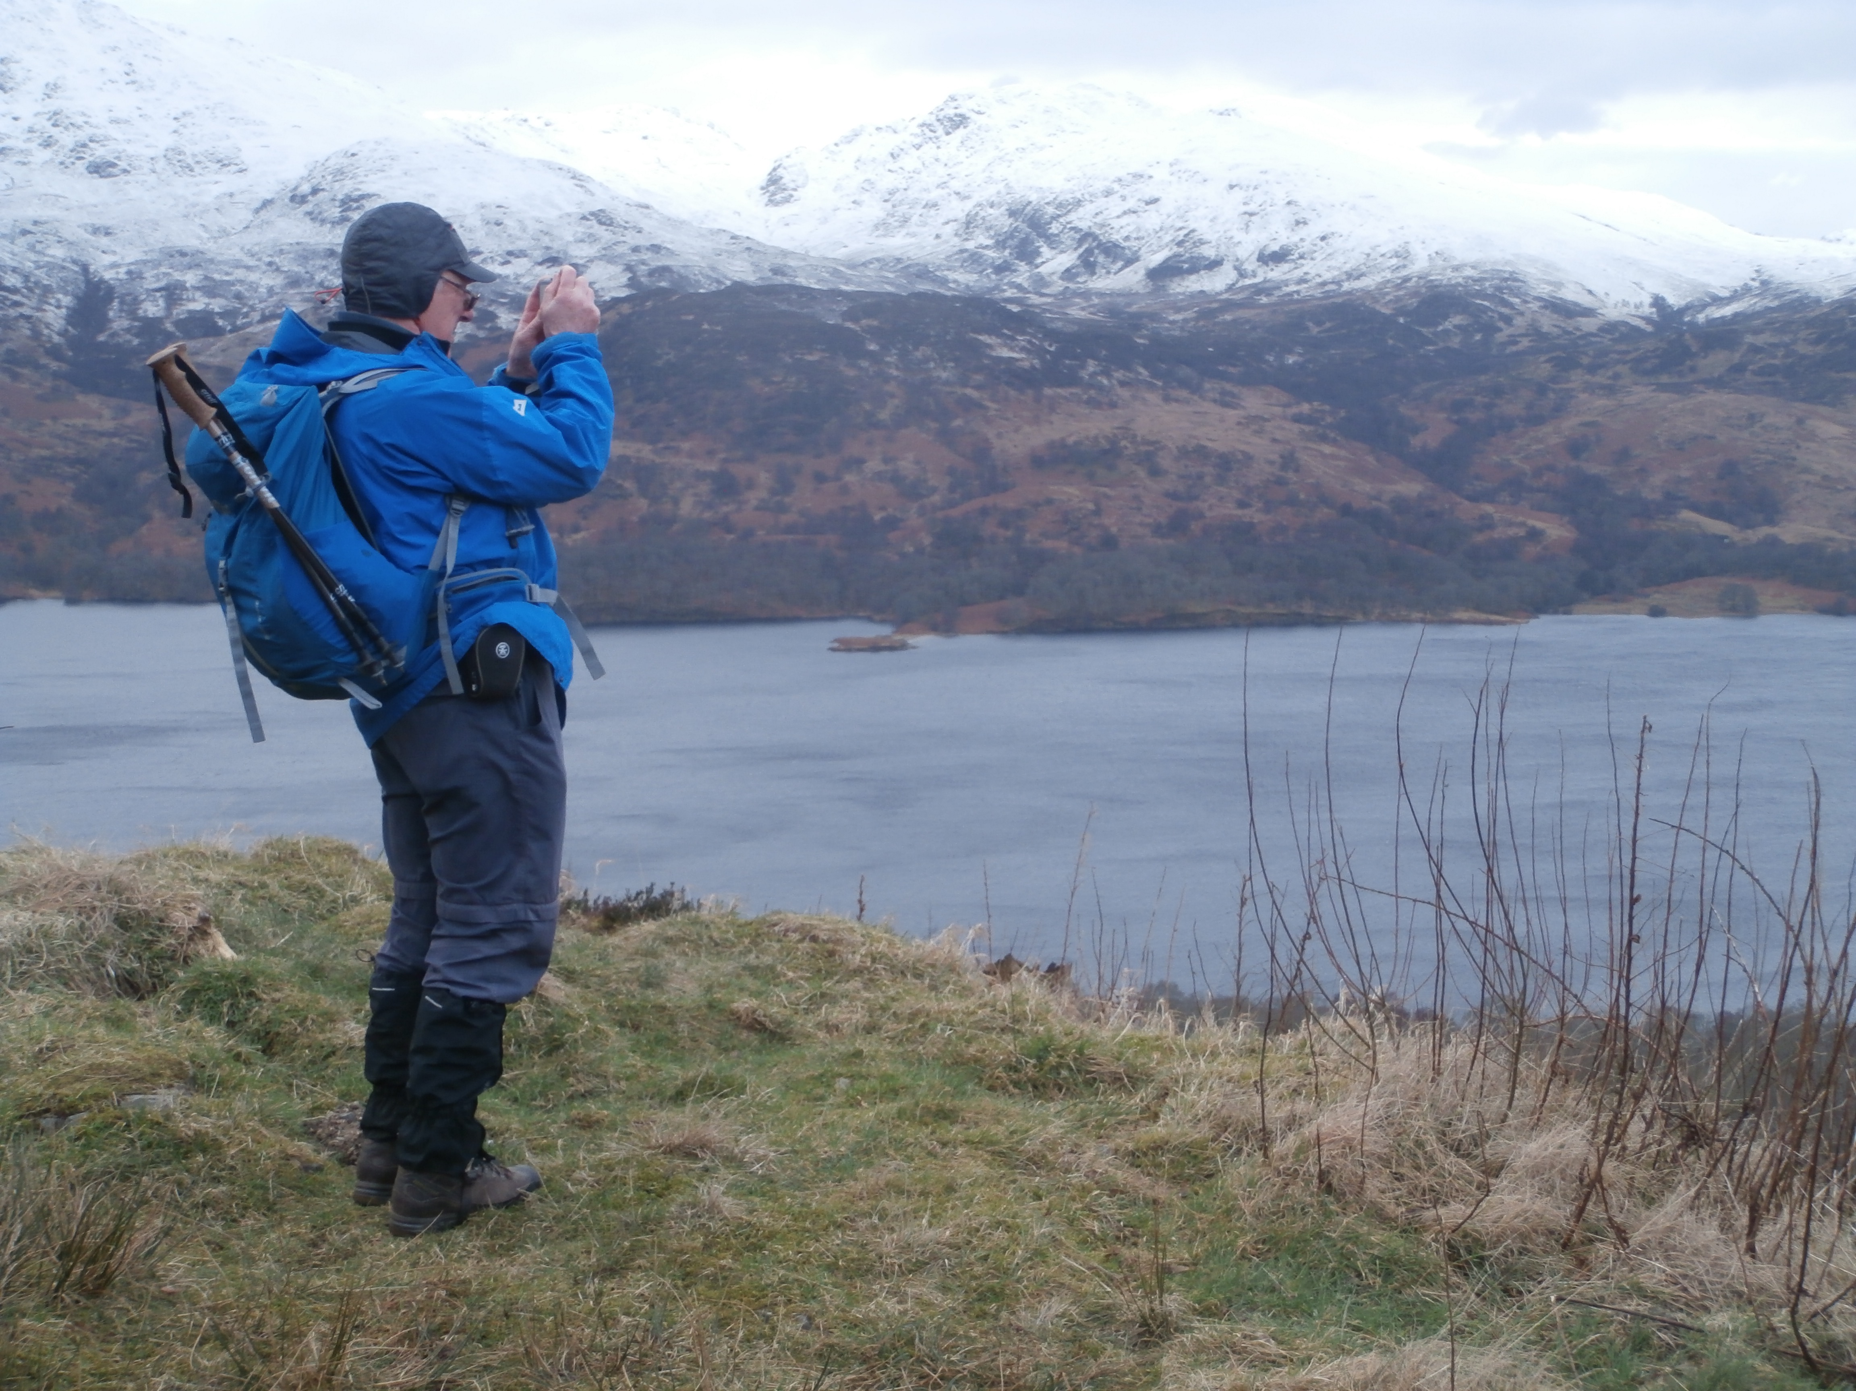

Slide 8
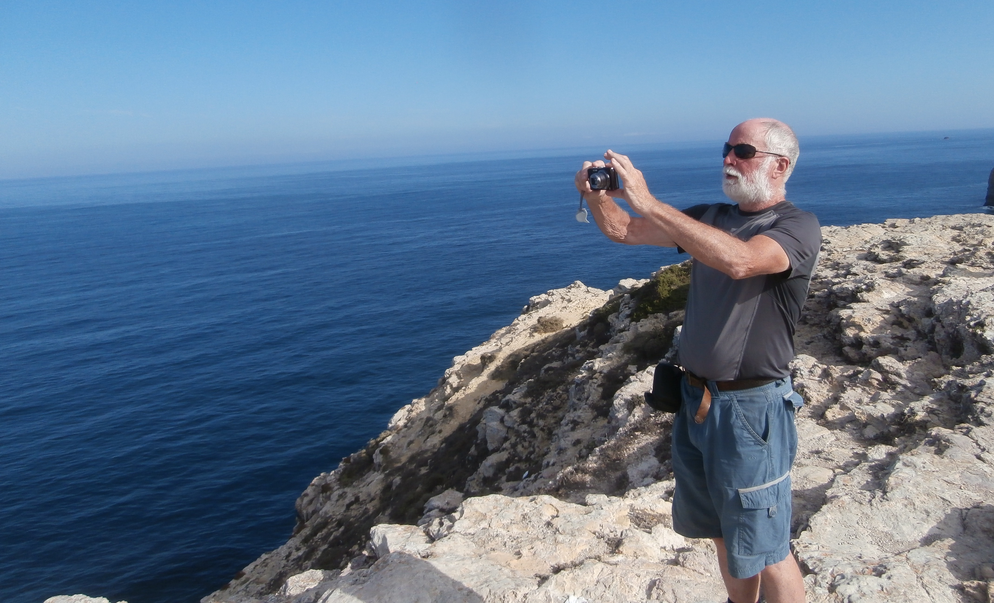

Slide 9
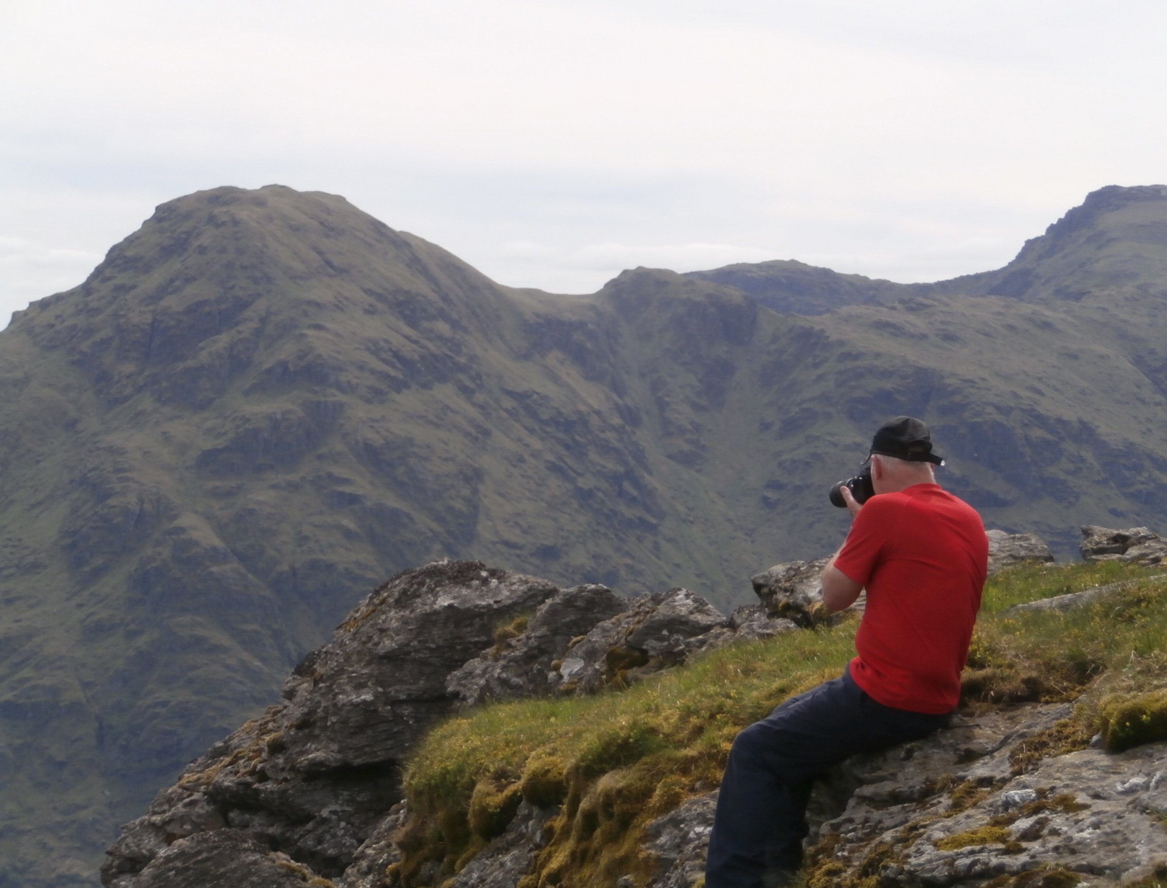

Slide 10
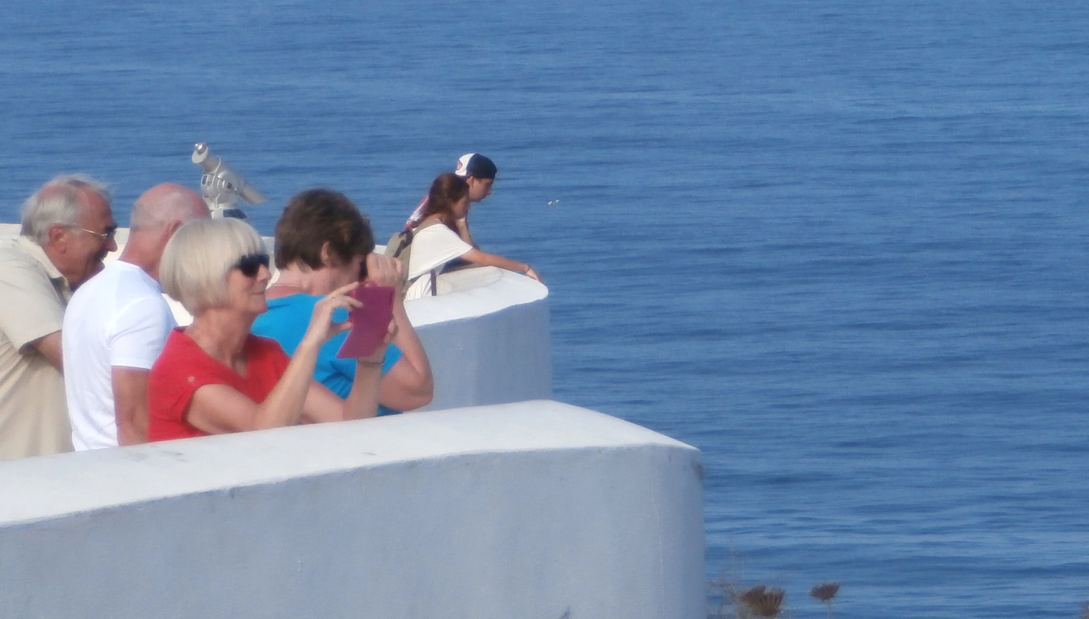

Slide 11
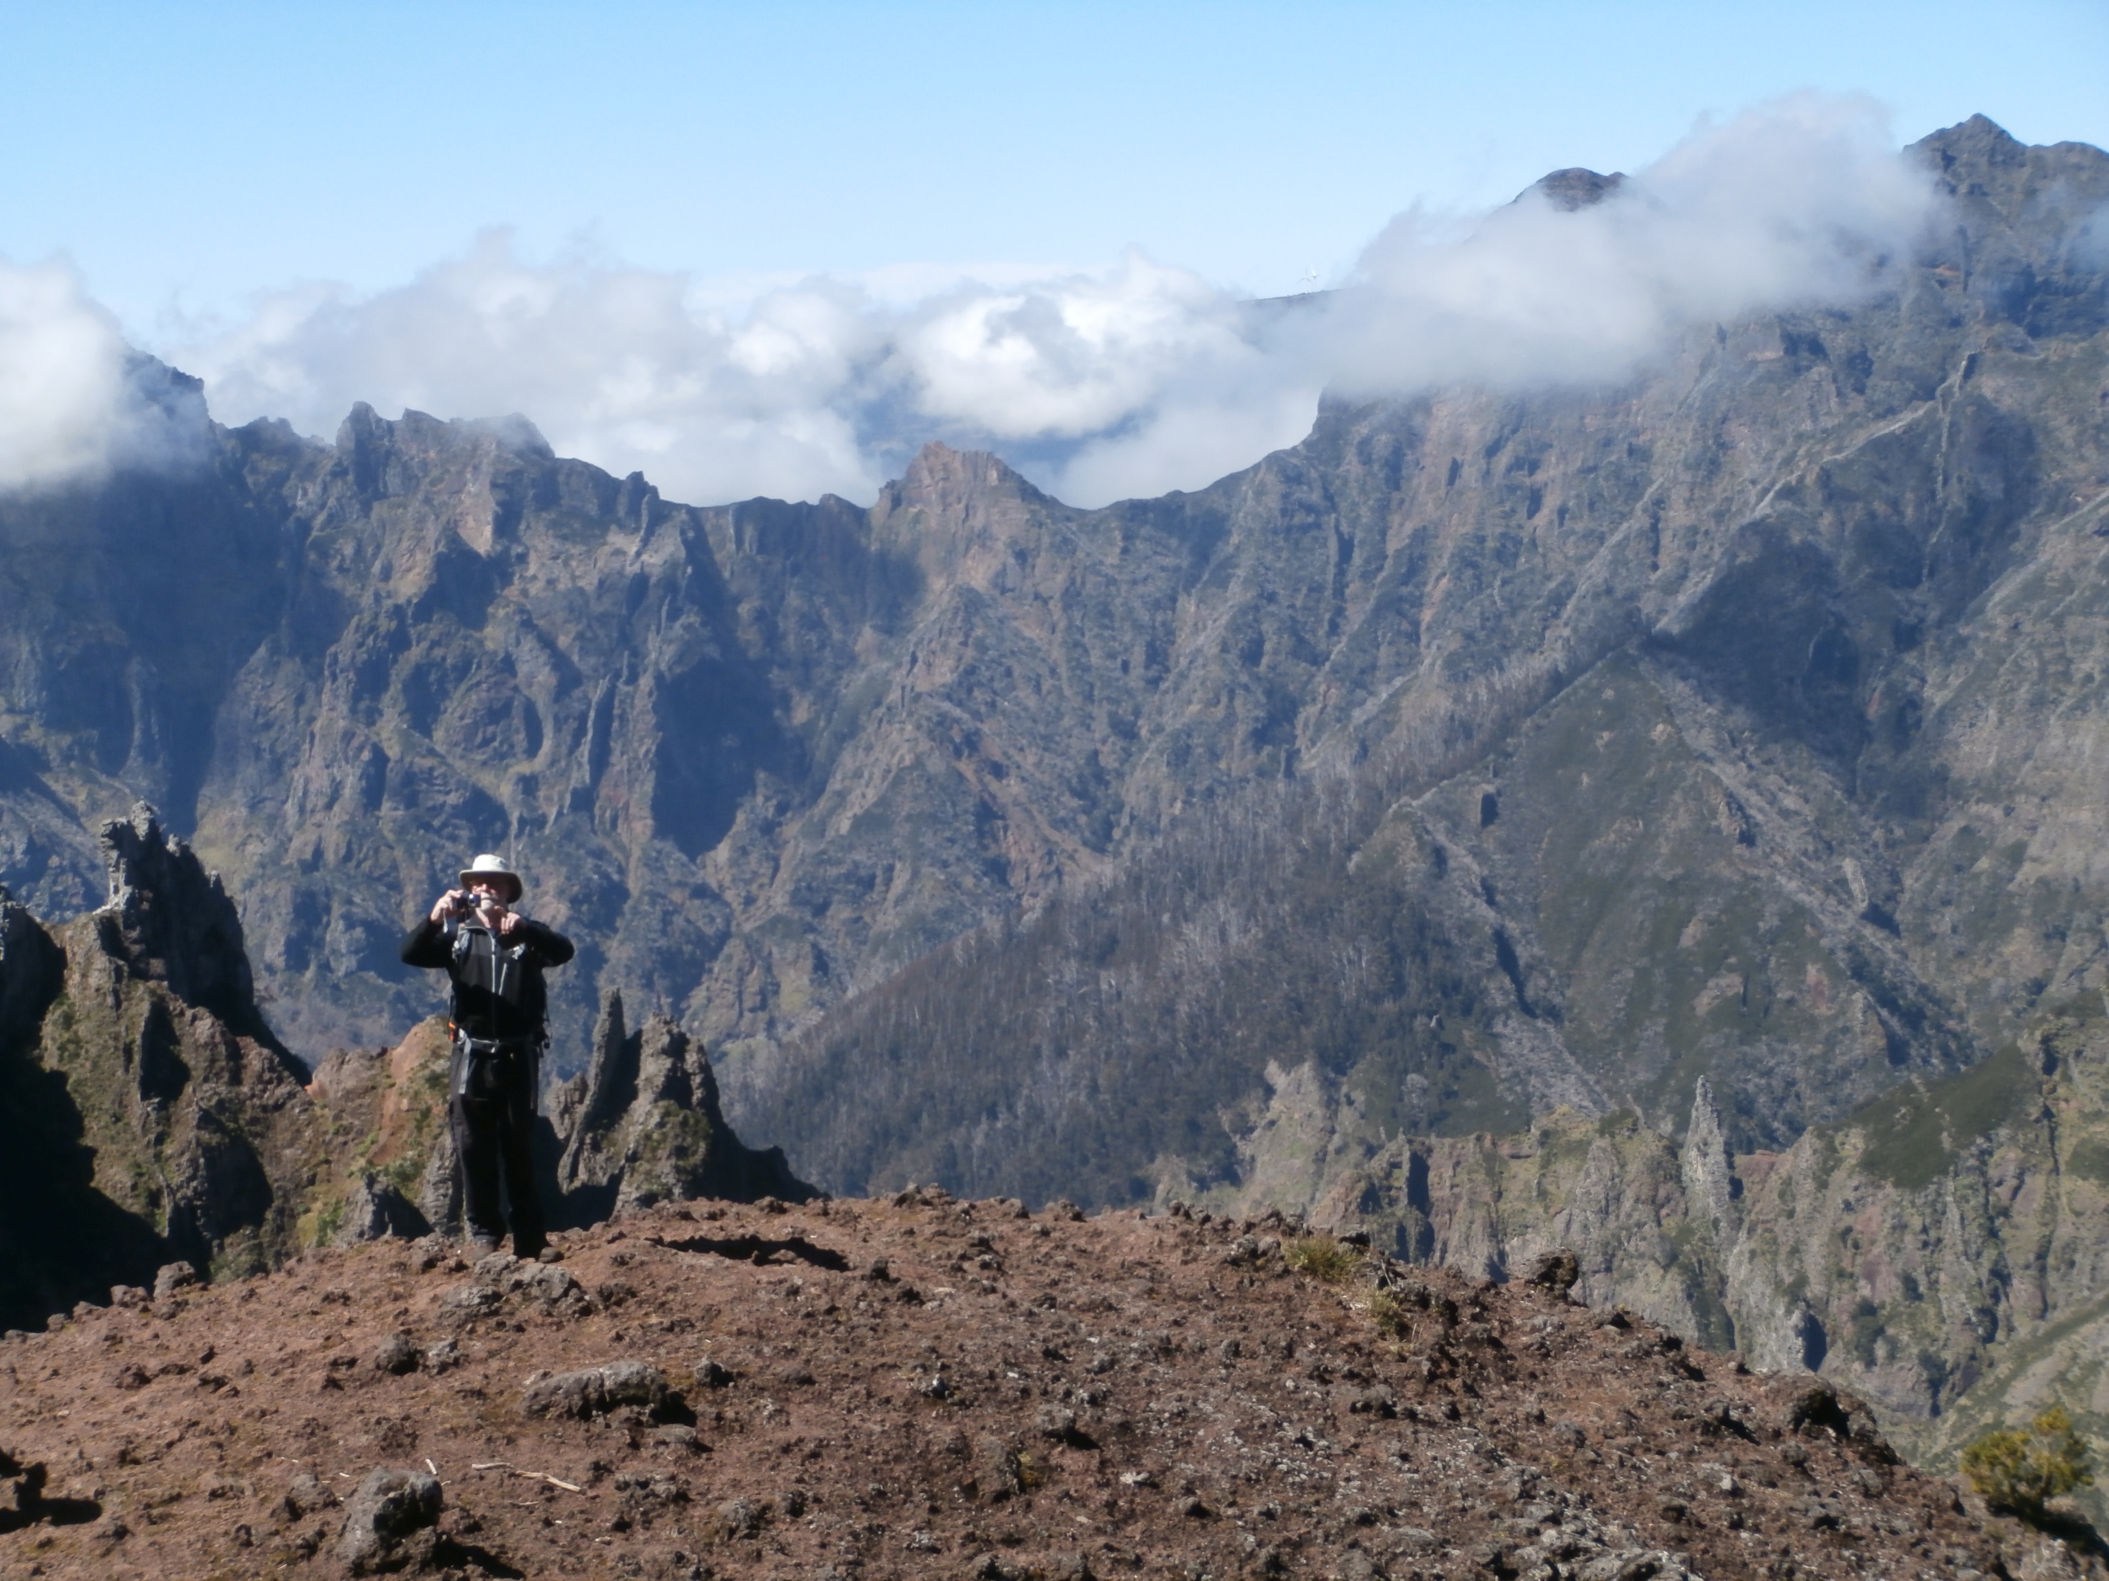

Slide 12
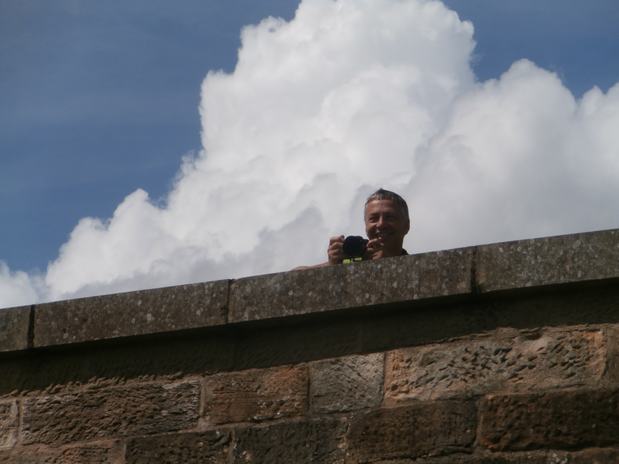
sheet ice …

Slide 13
Portraitists ?

Slide 14
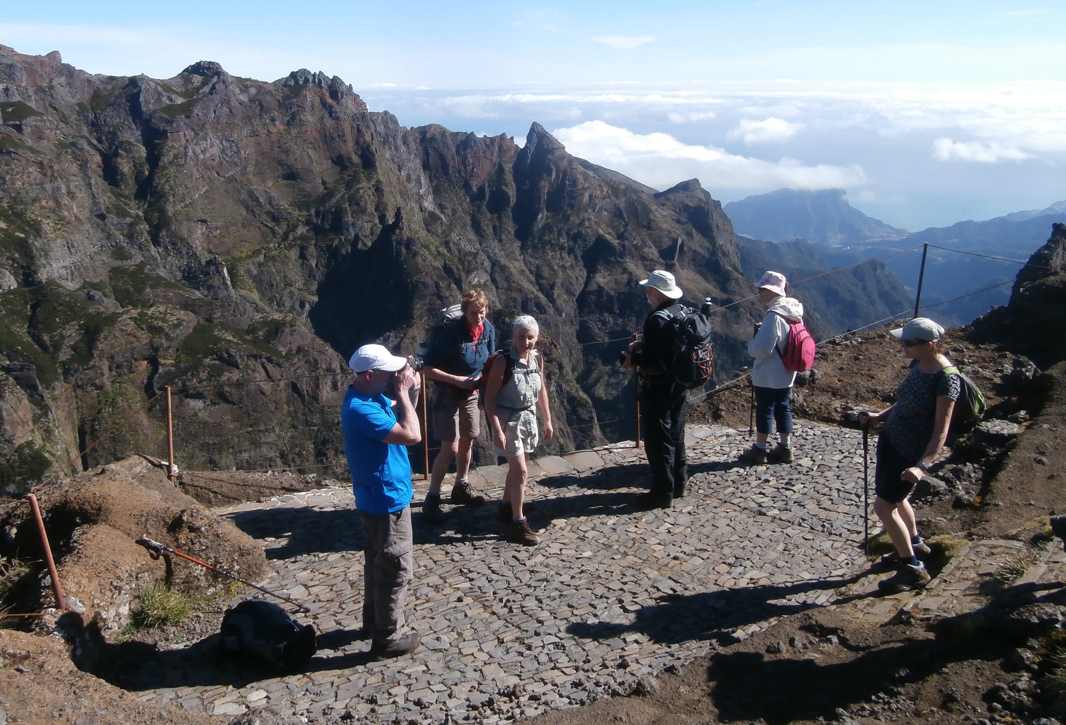

Slide 15
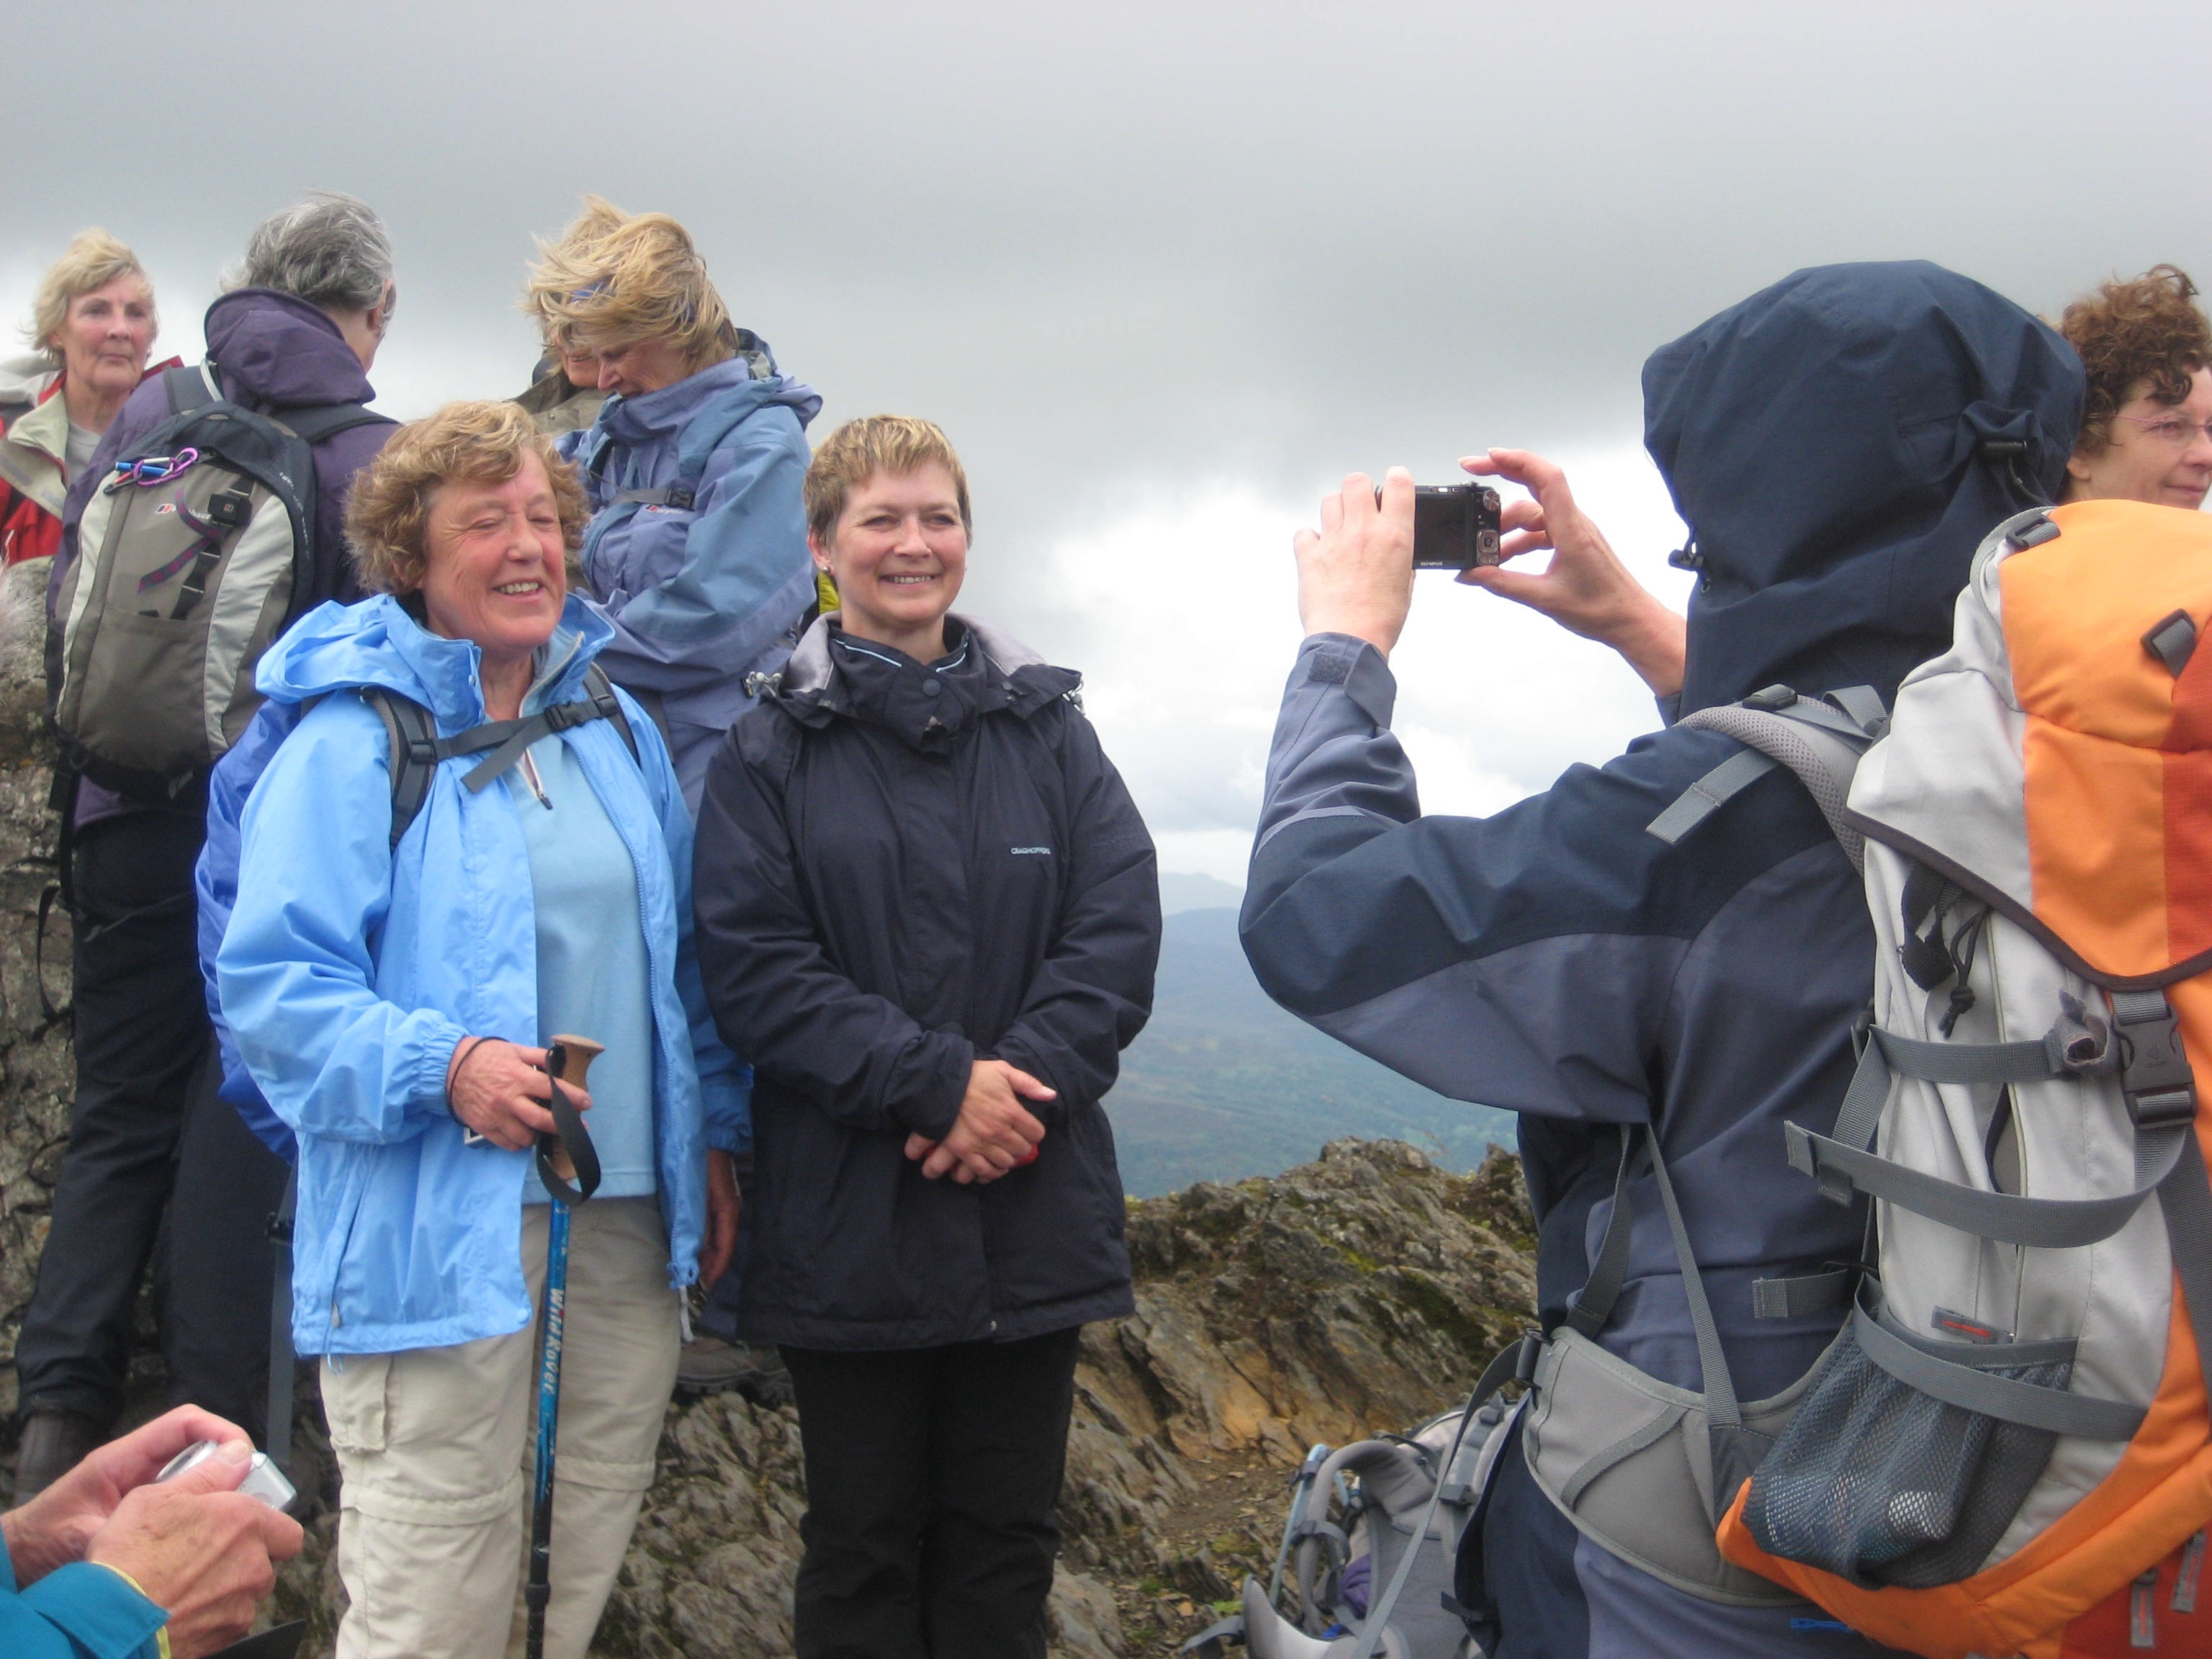
no path… we are ’off piste’

Slide 16
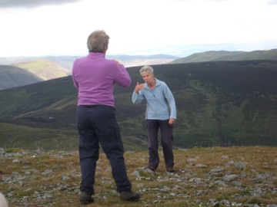

Slide 17
Detailists ?

Slide 18
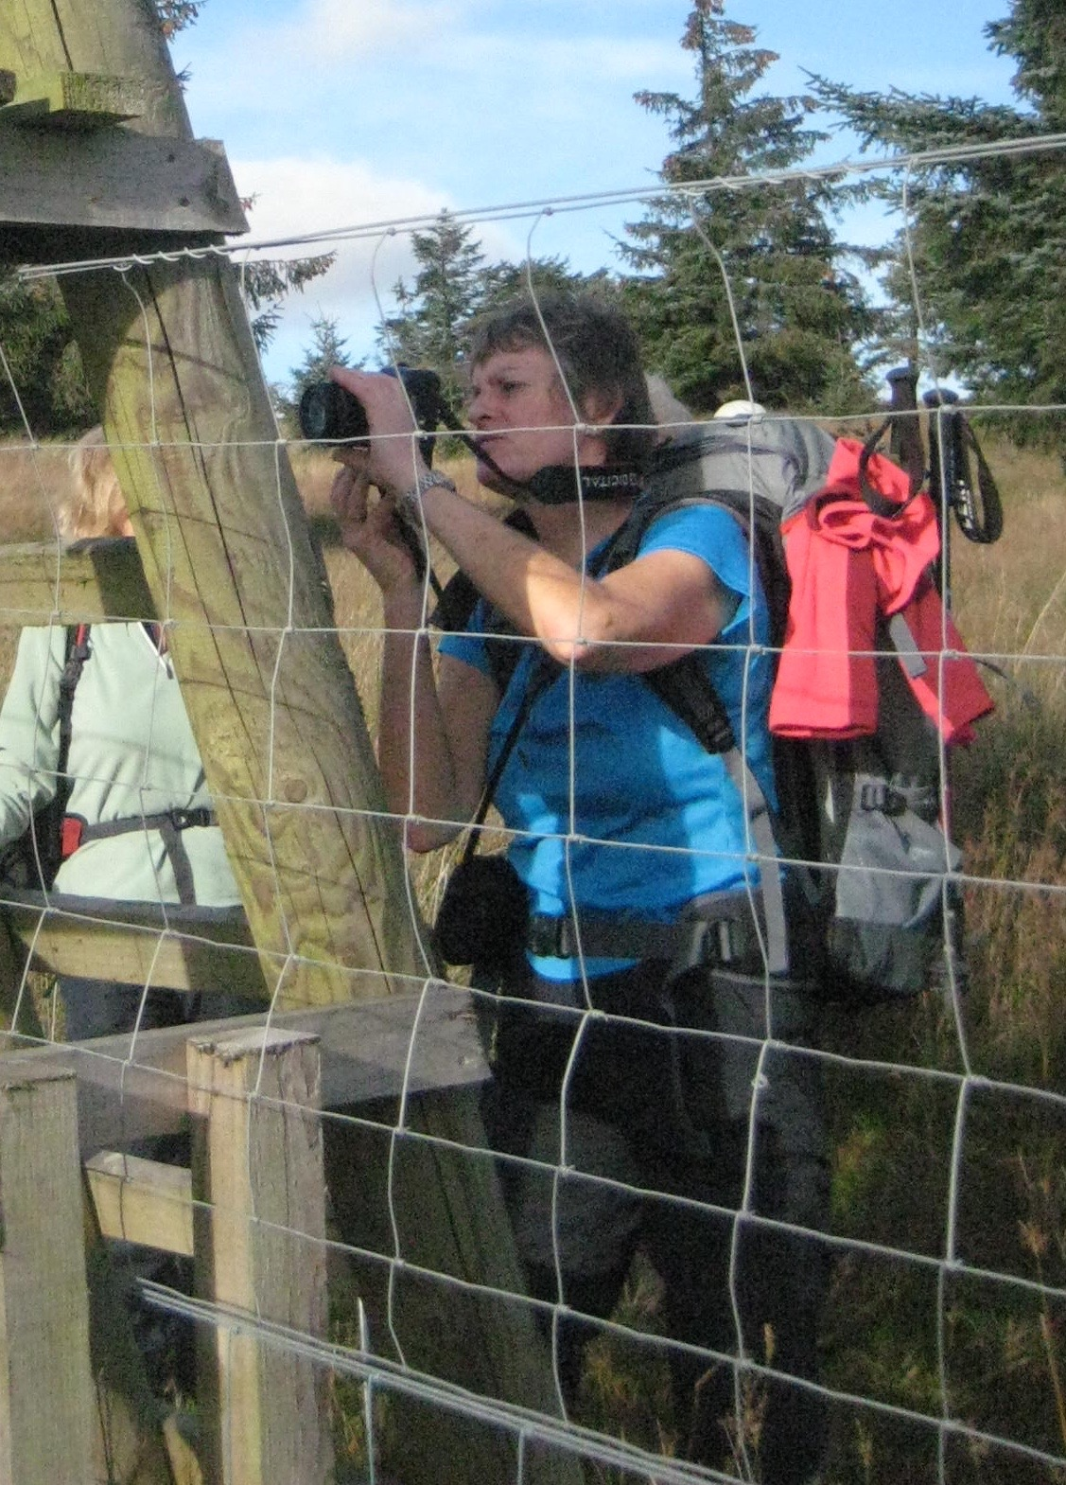

Slide 19
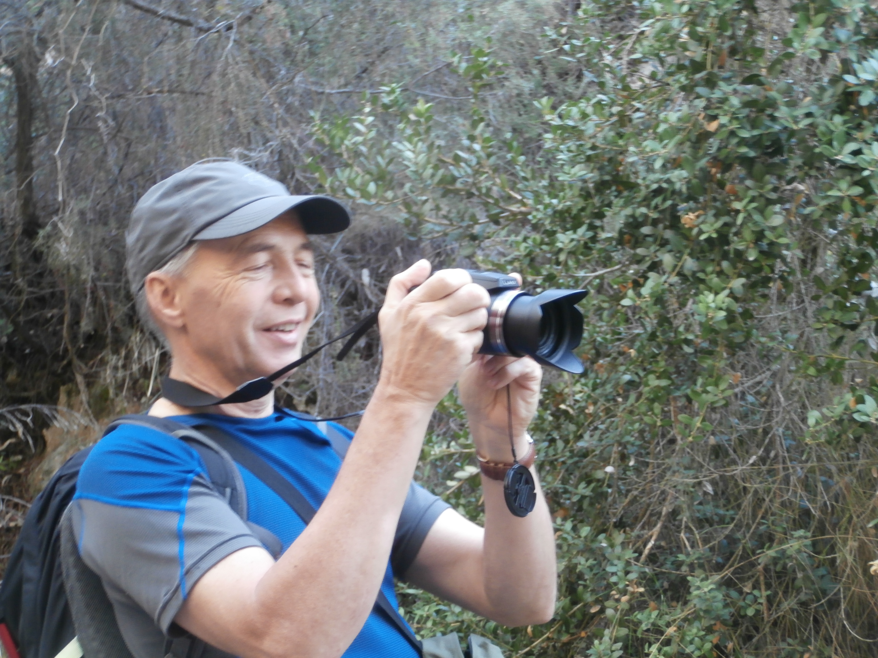

Slide 20
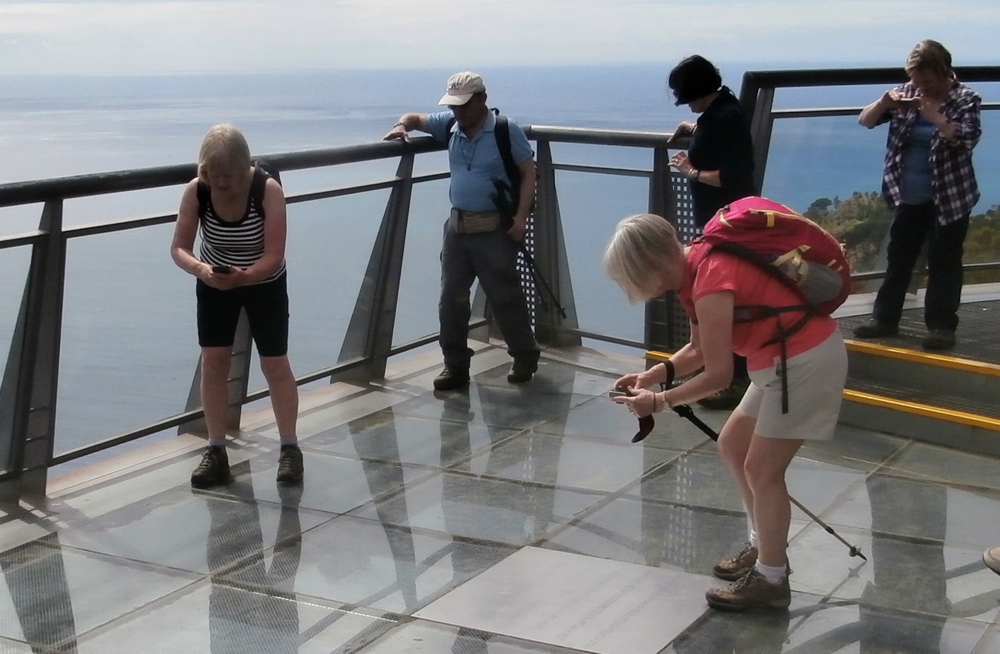

Slide 21
Naturalists ?

Slide 22
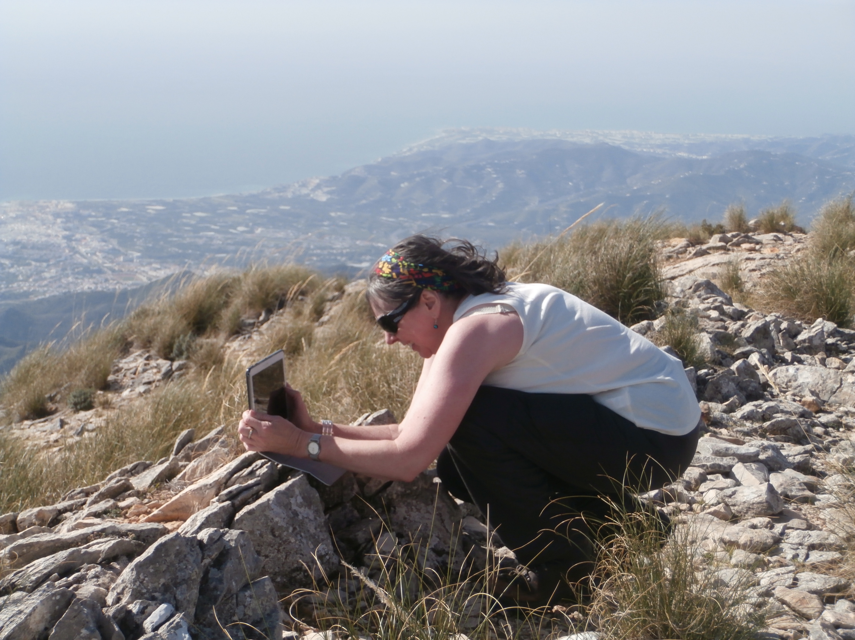

Slide 23
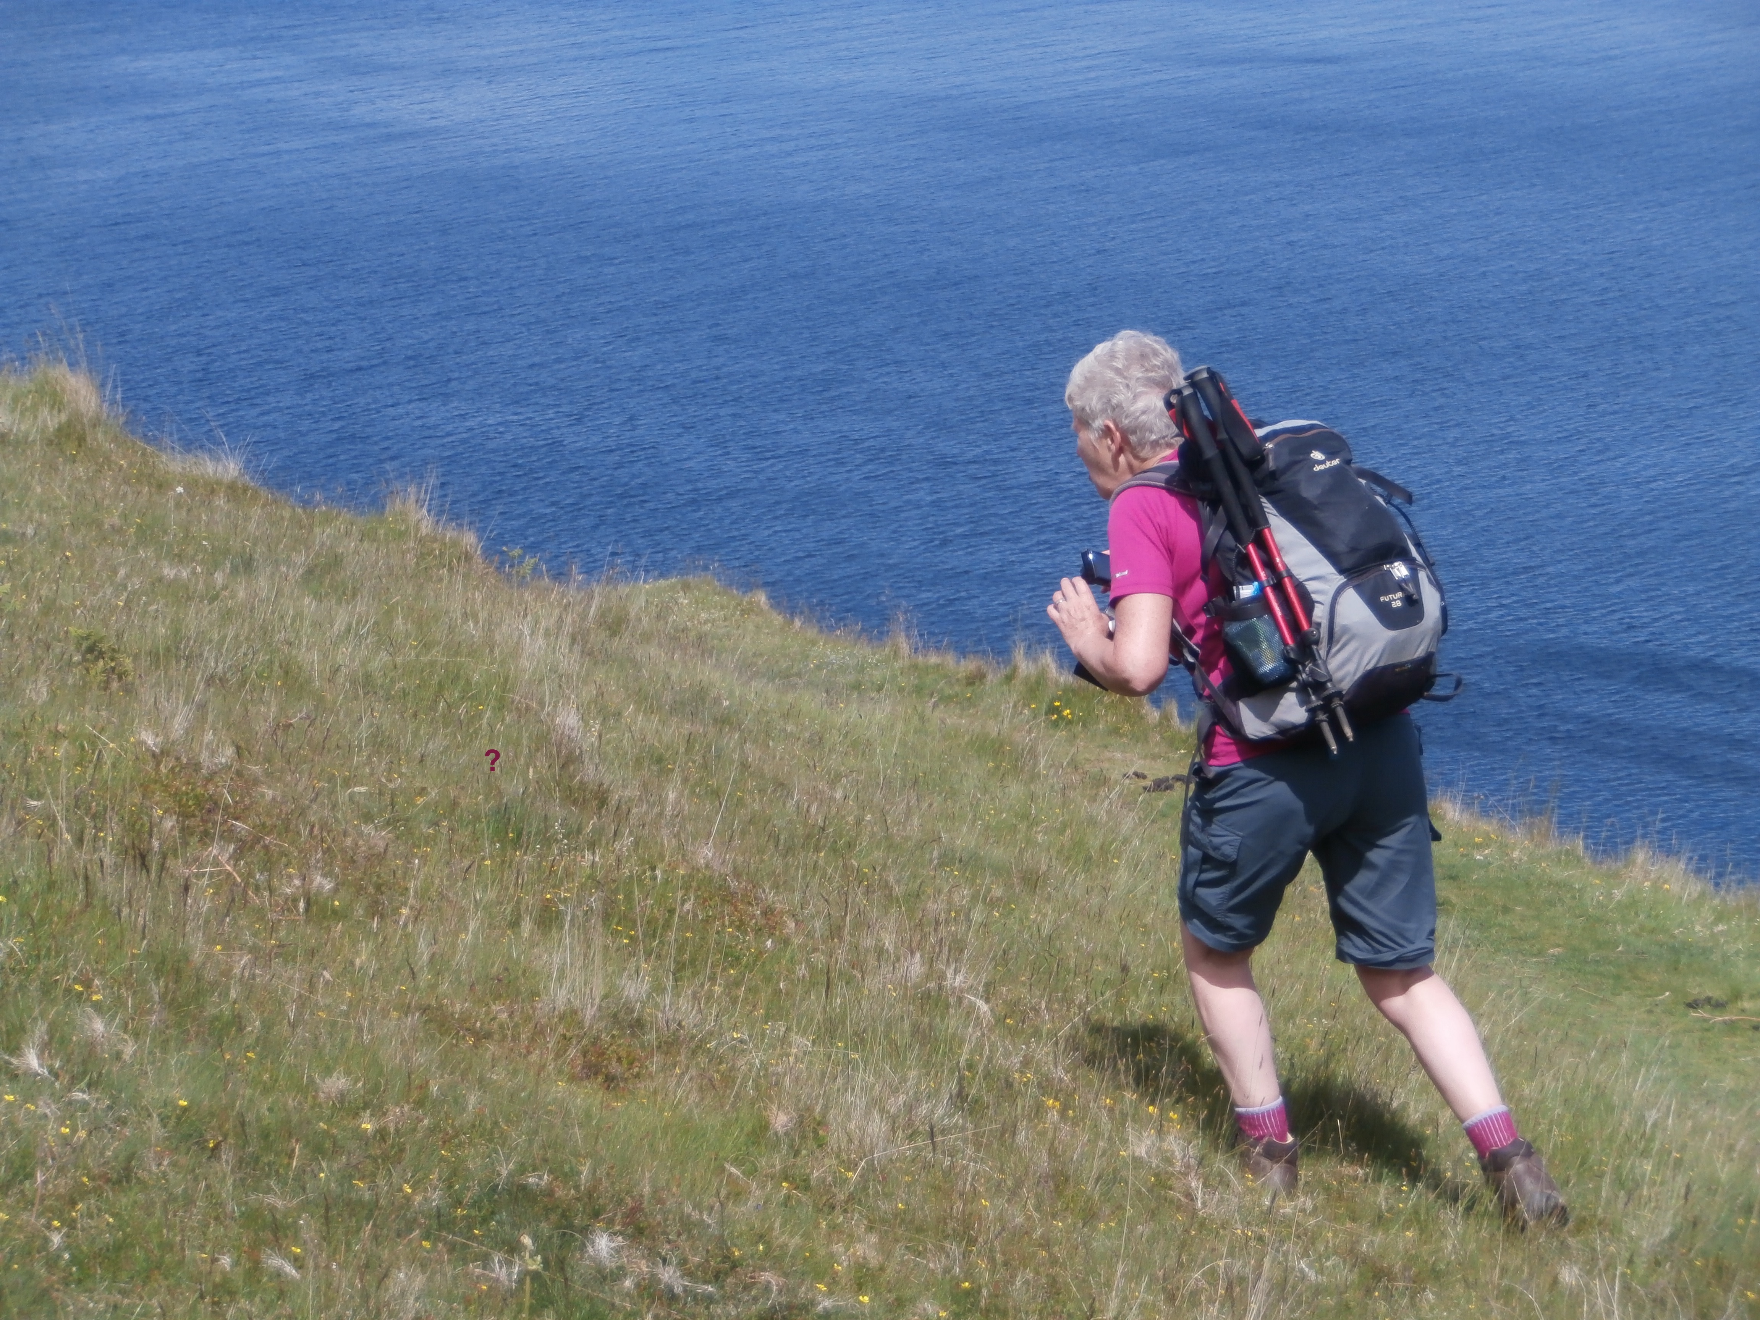

Slide 24
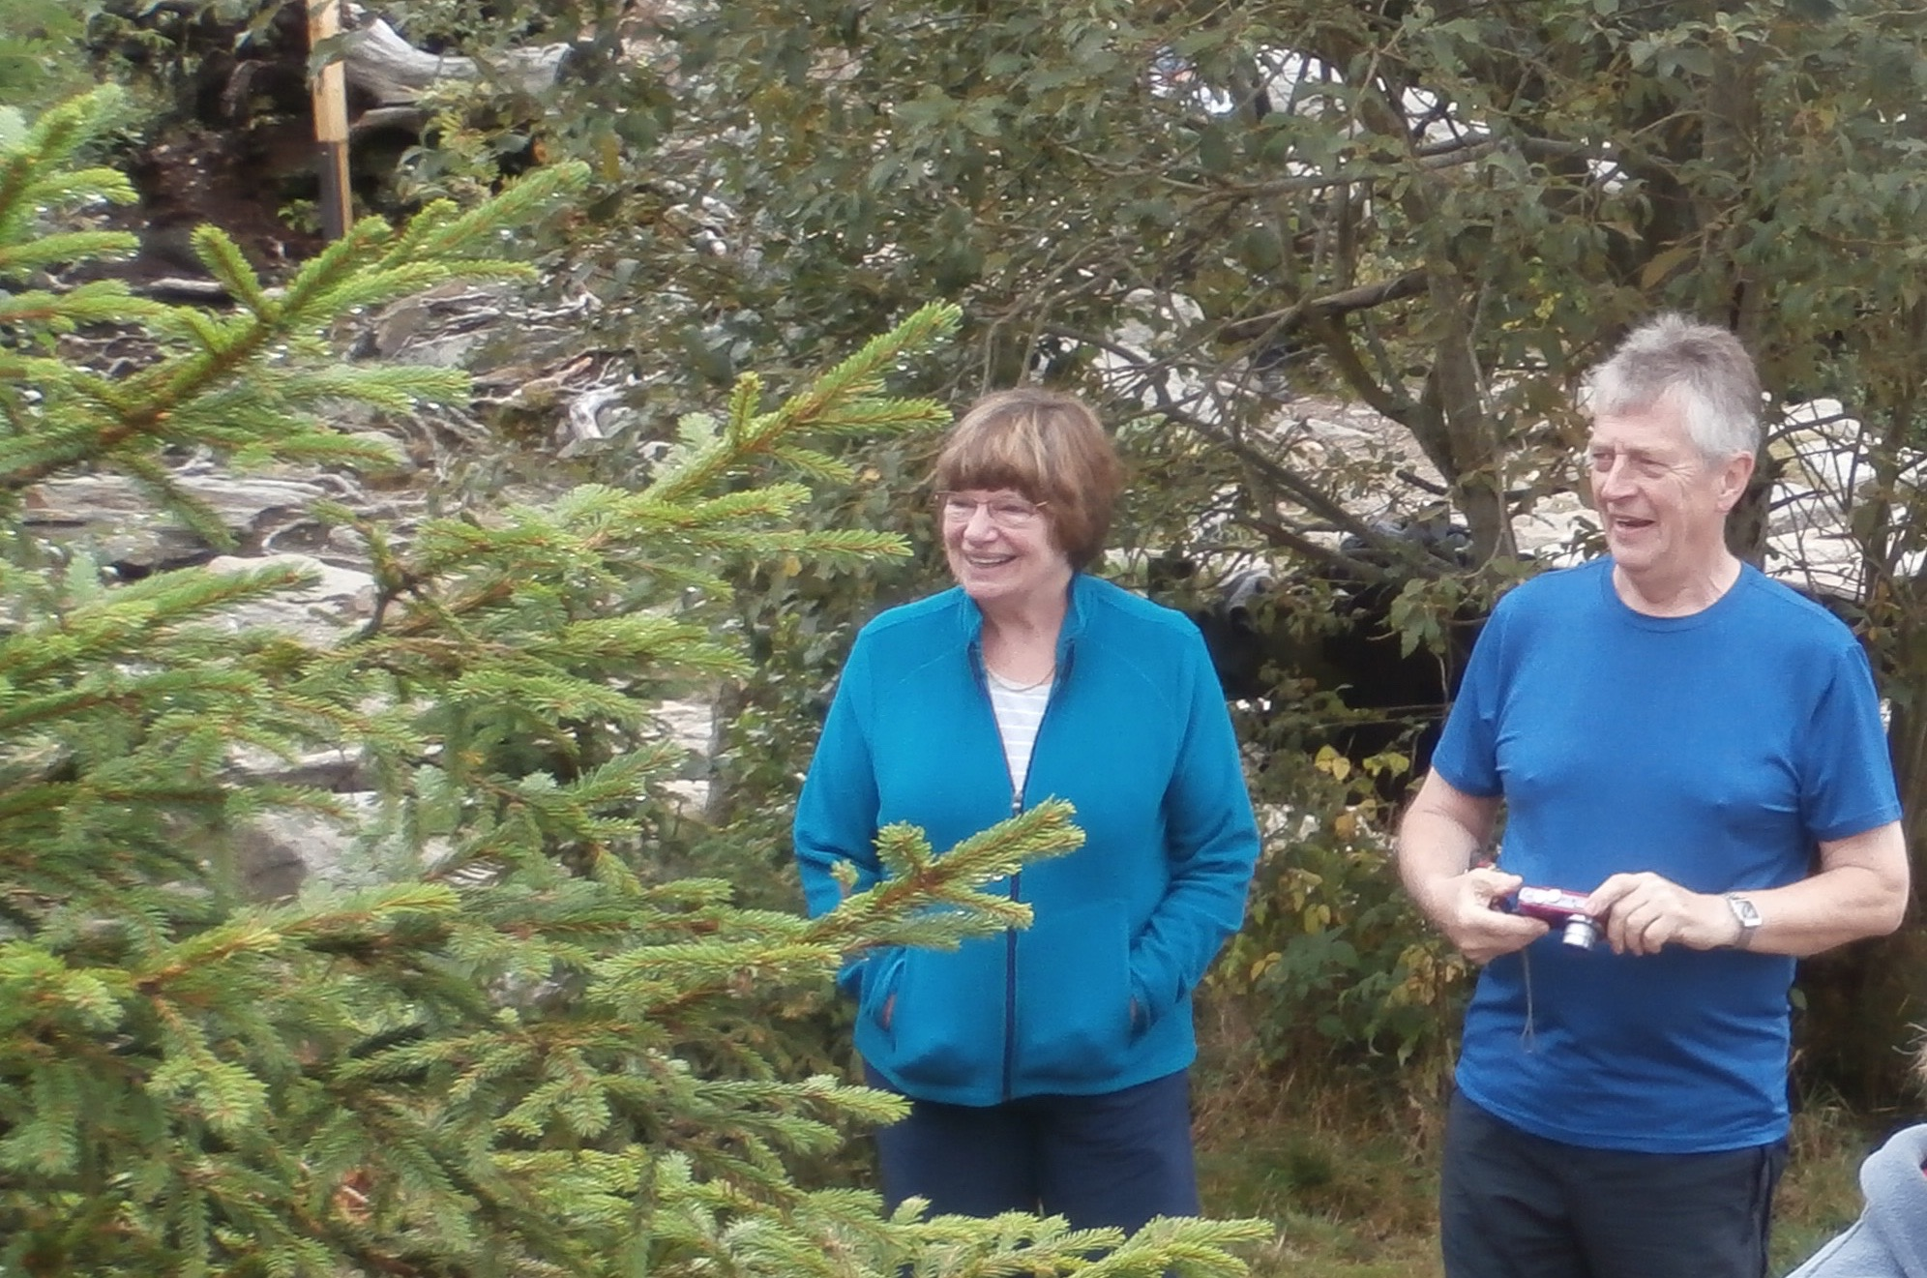

Slide 25
Documentarists ?

Slide 26
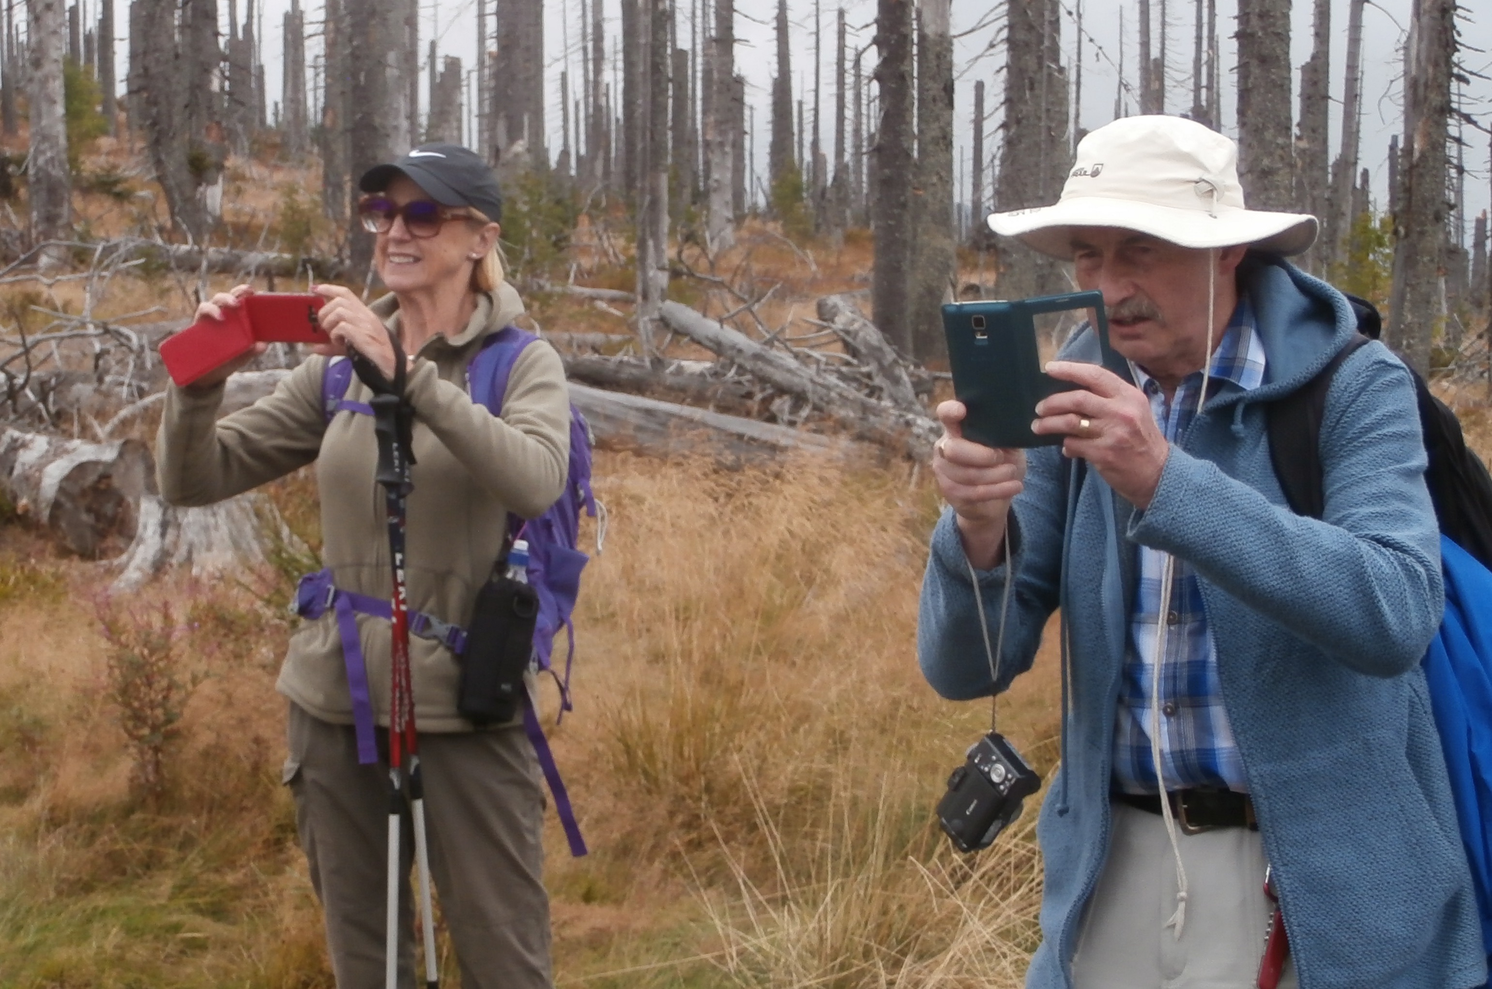

Slide 27
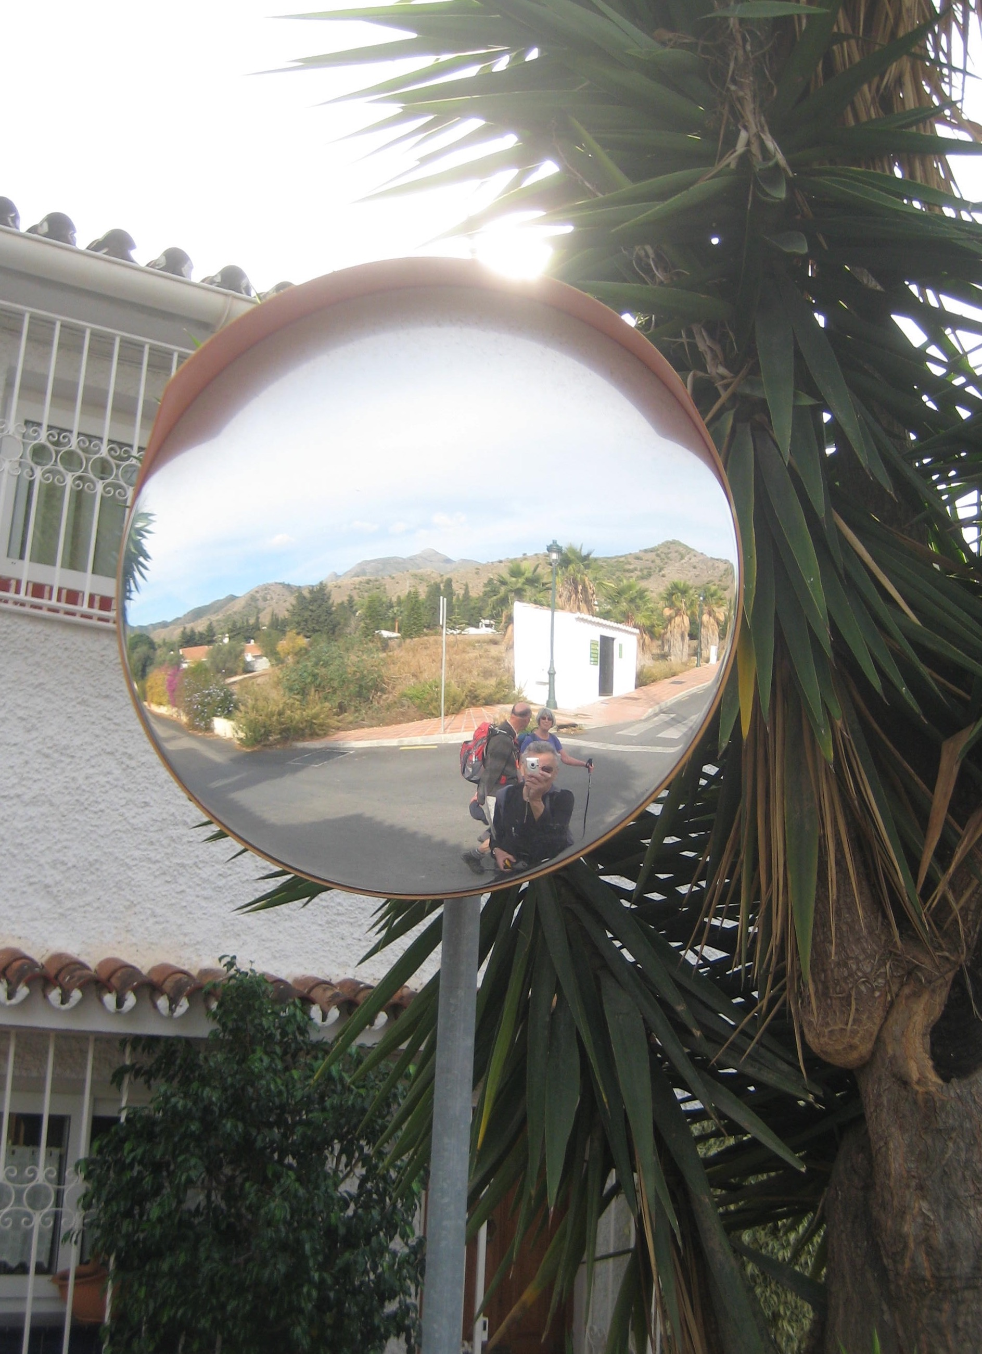

Slide 28
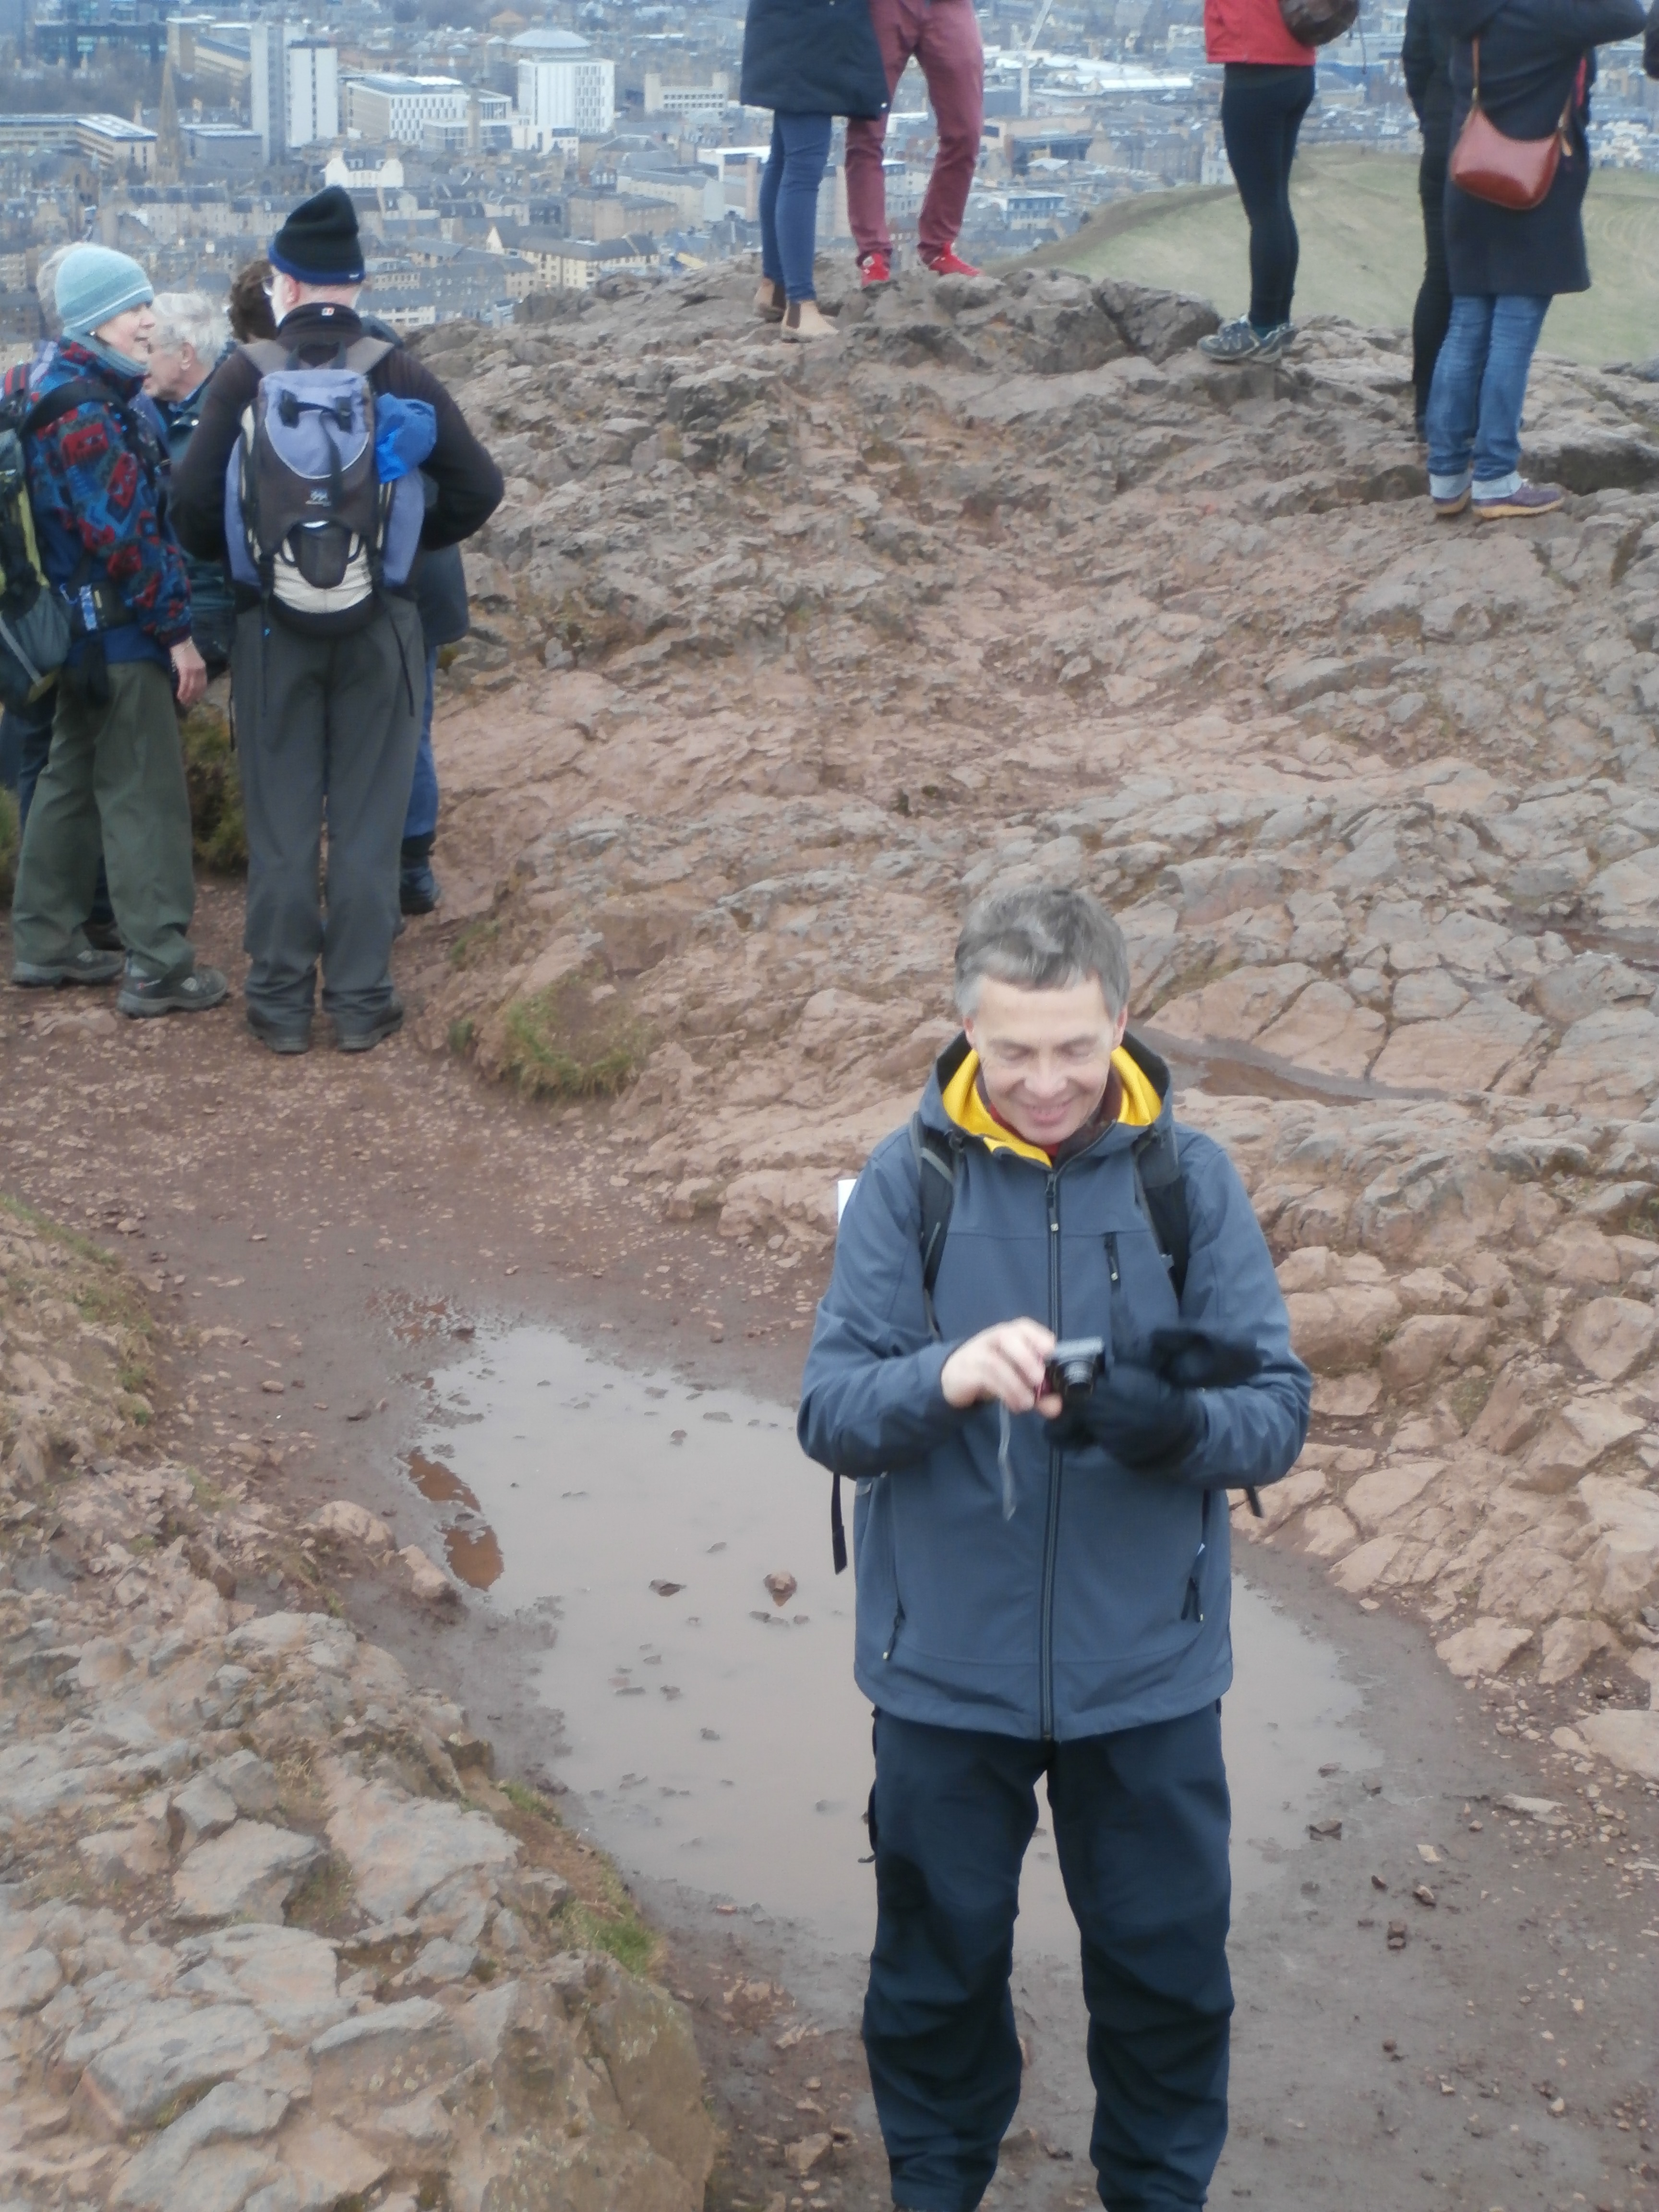

Slide 29
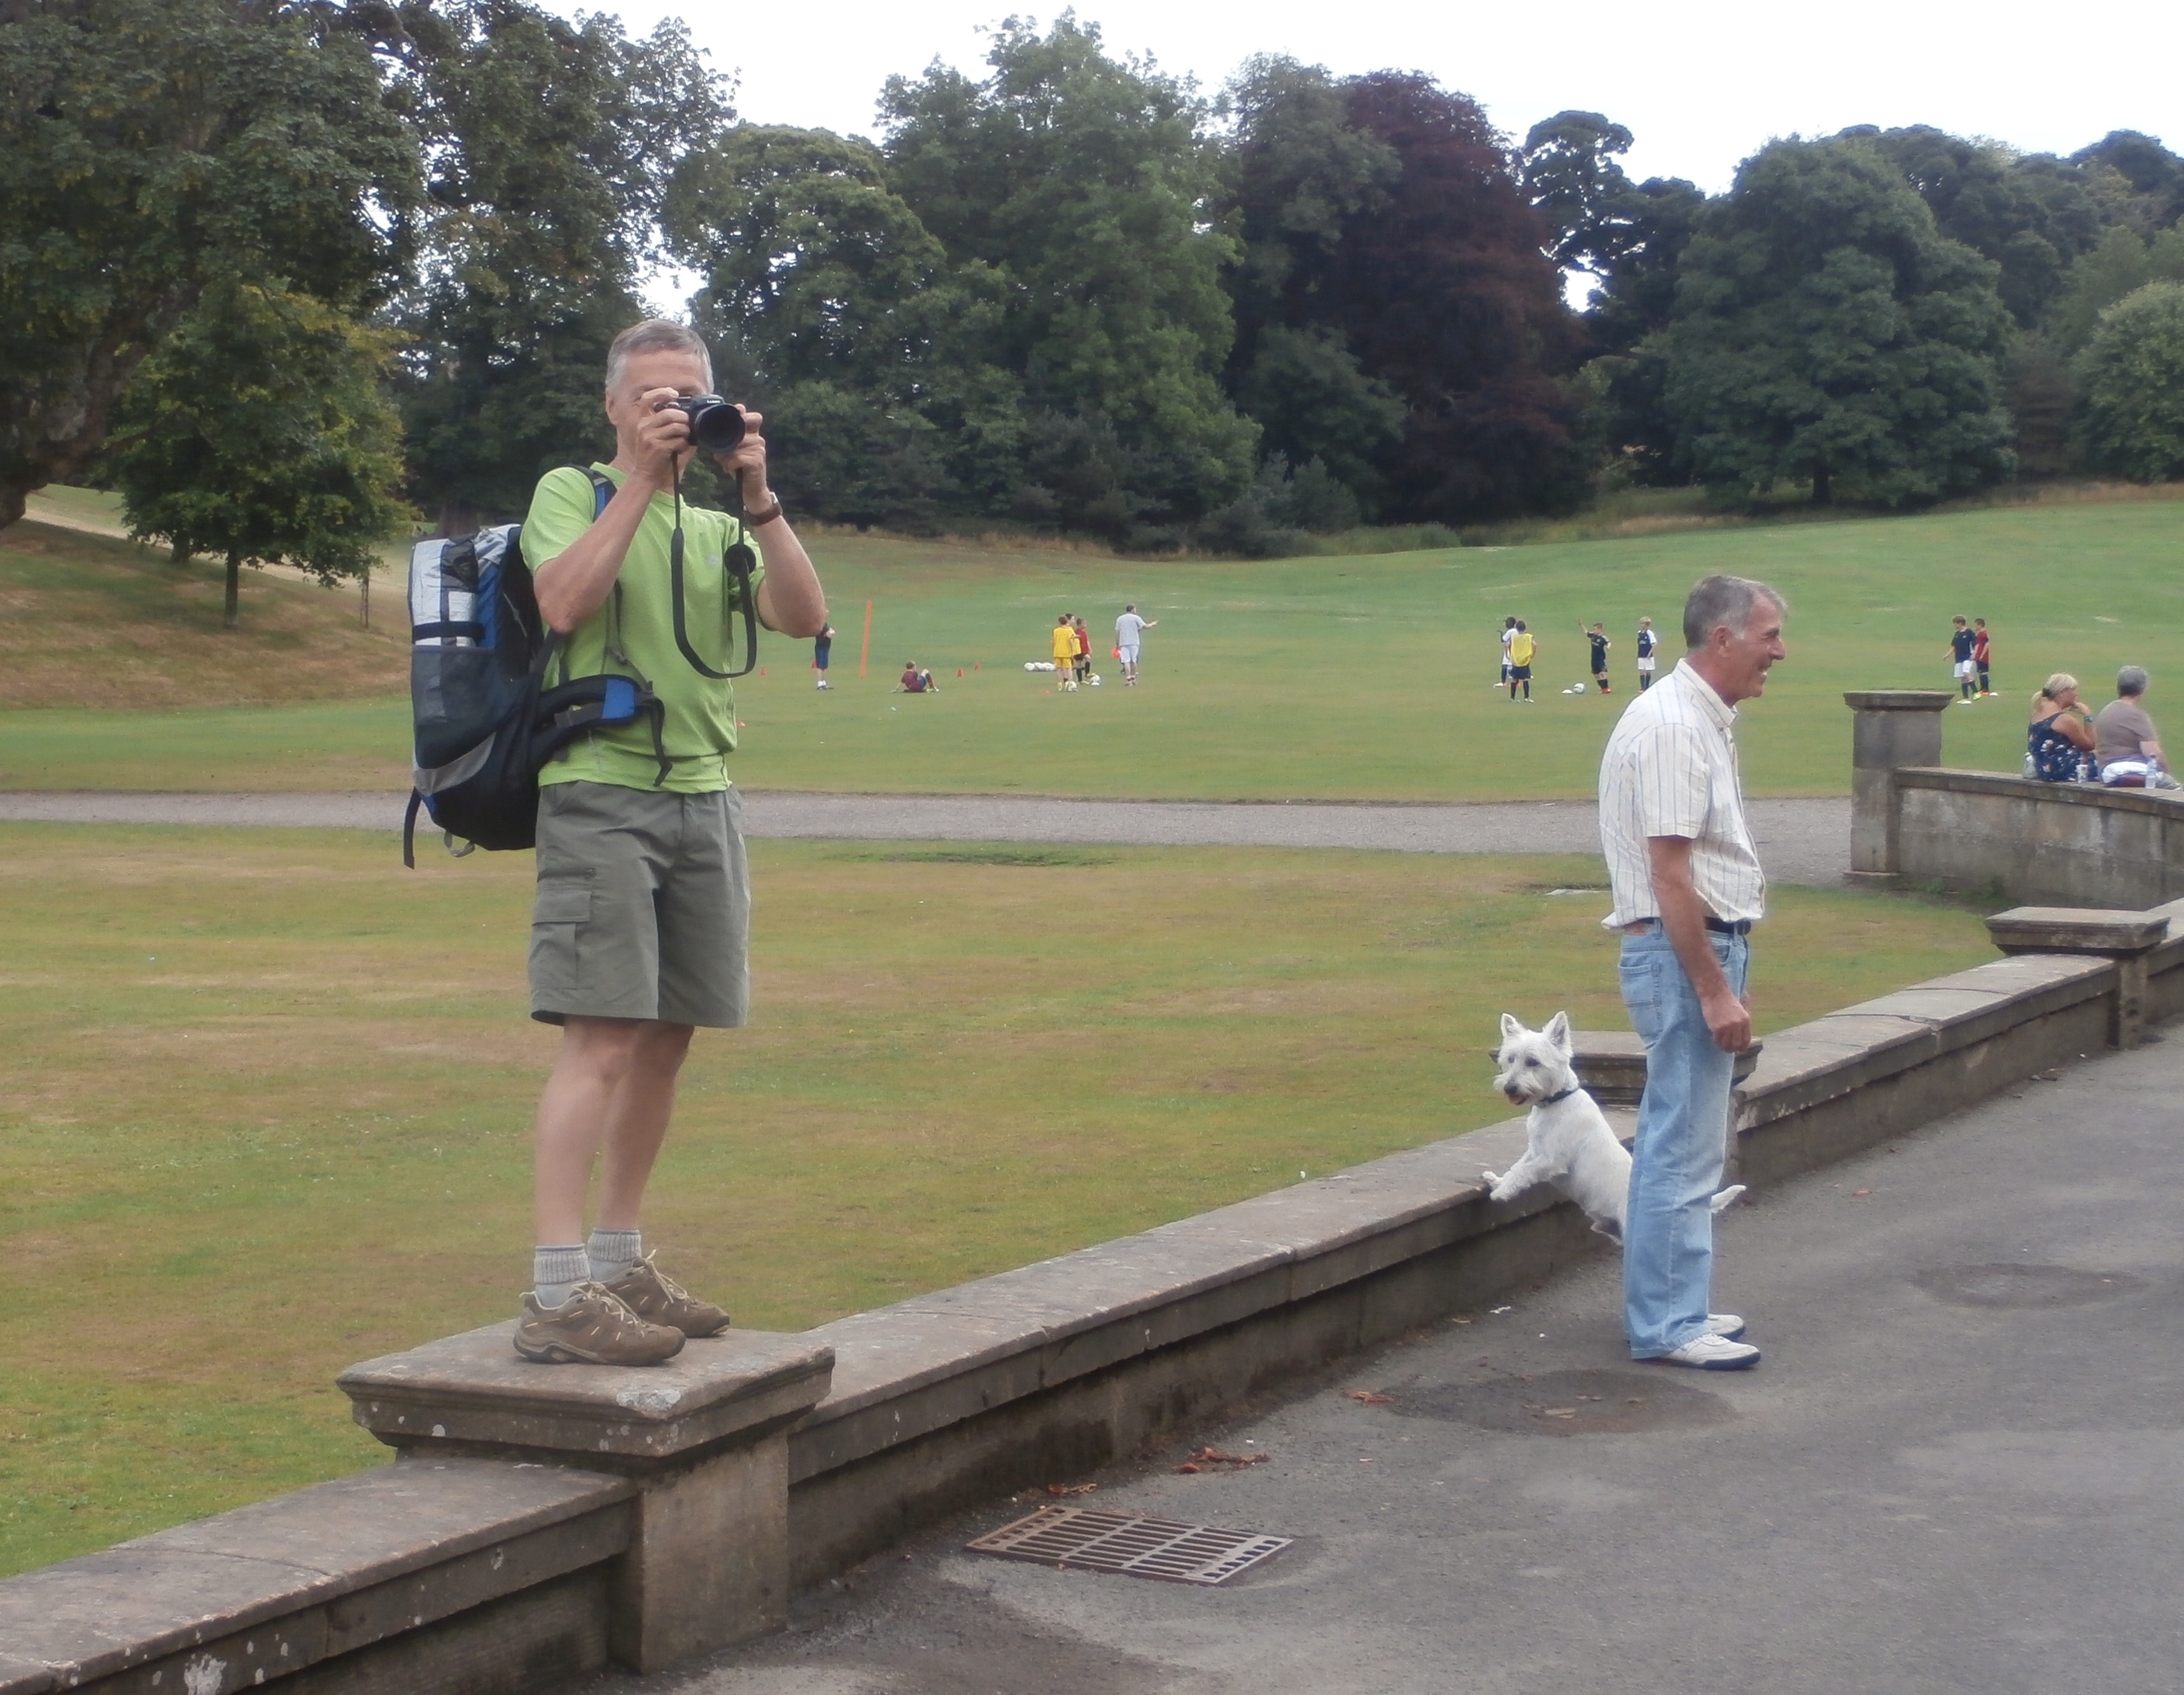

Slide 30
Summitteers ?

Slide 31
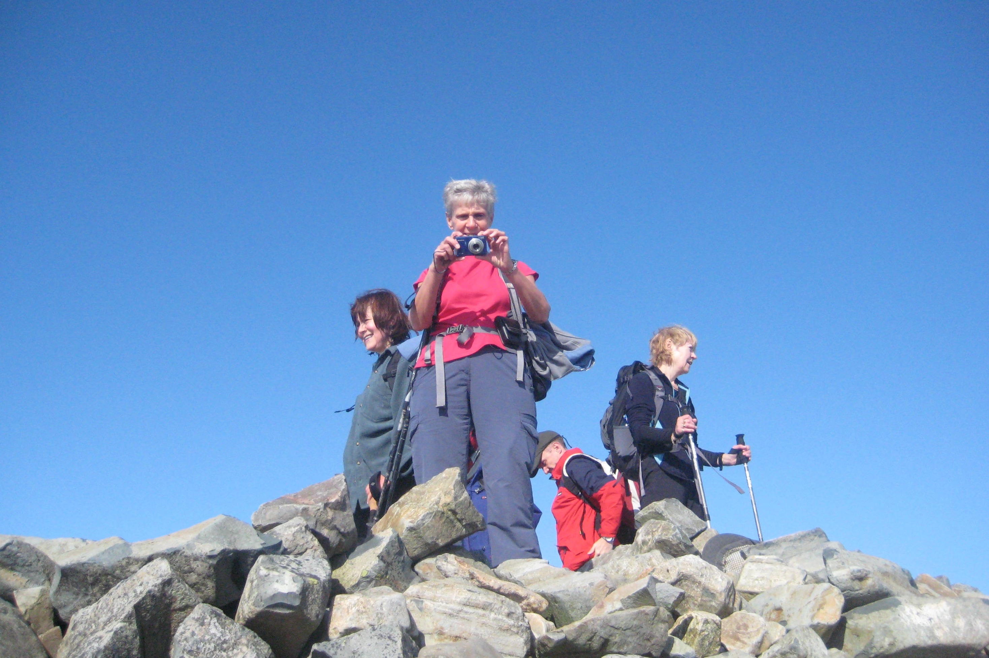

Slide 32
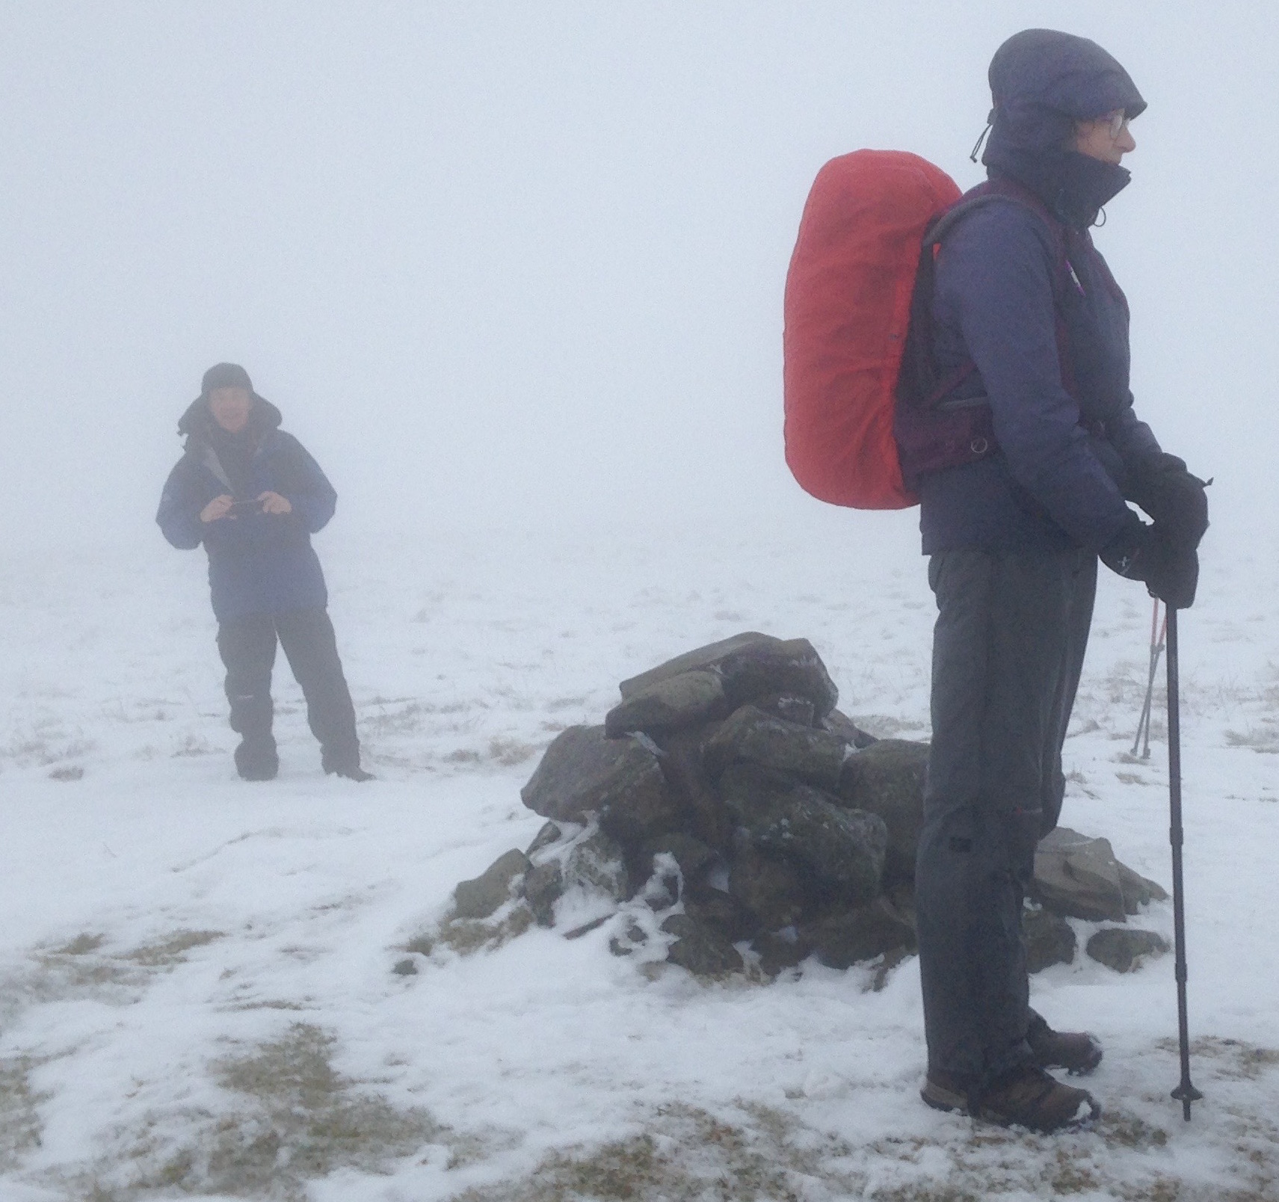

Slide 33
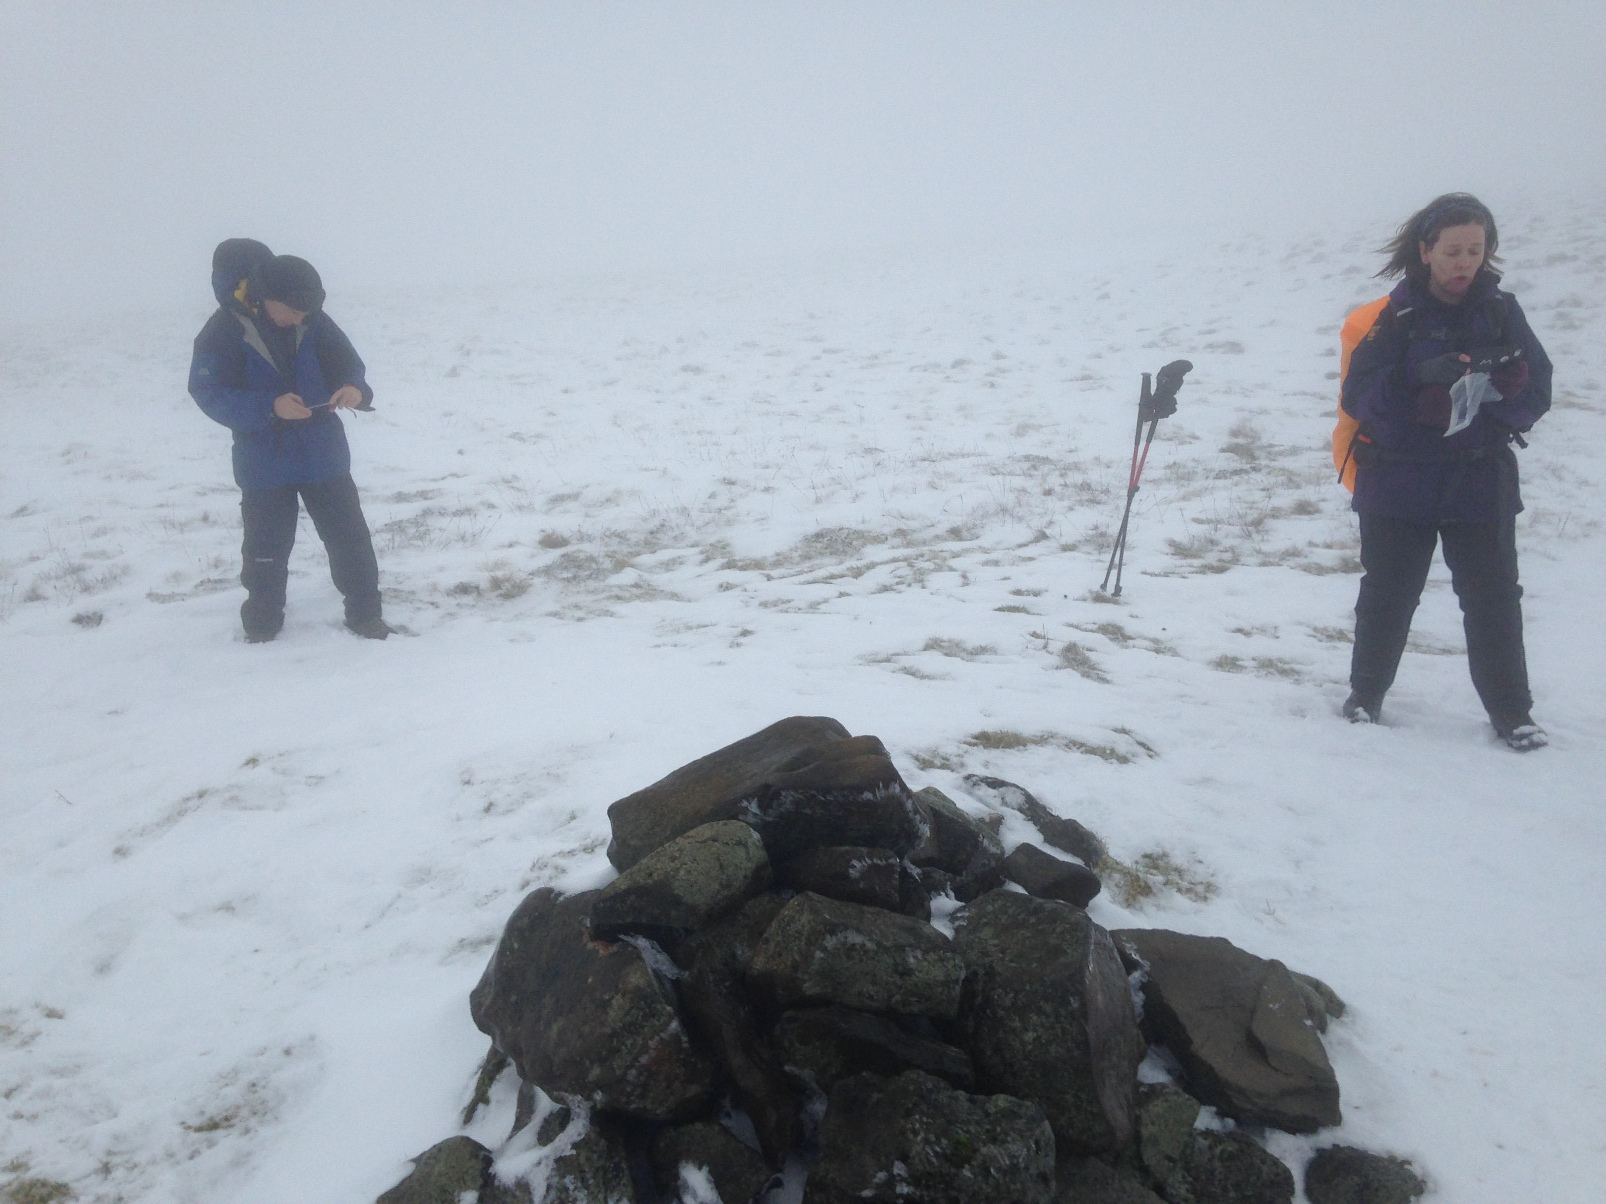

Slide 34
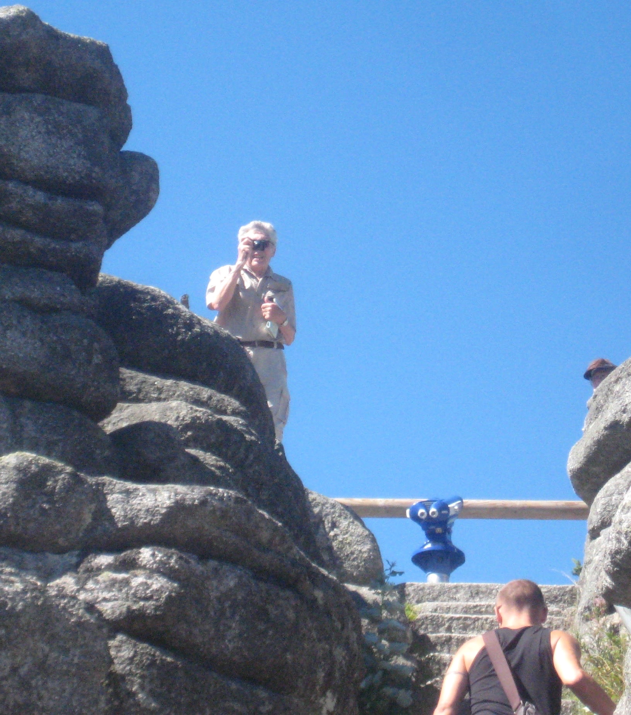

Slide 35
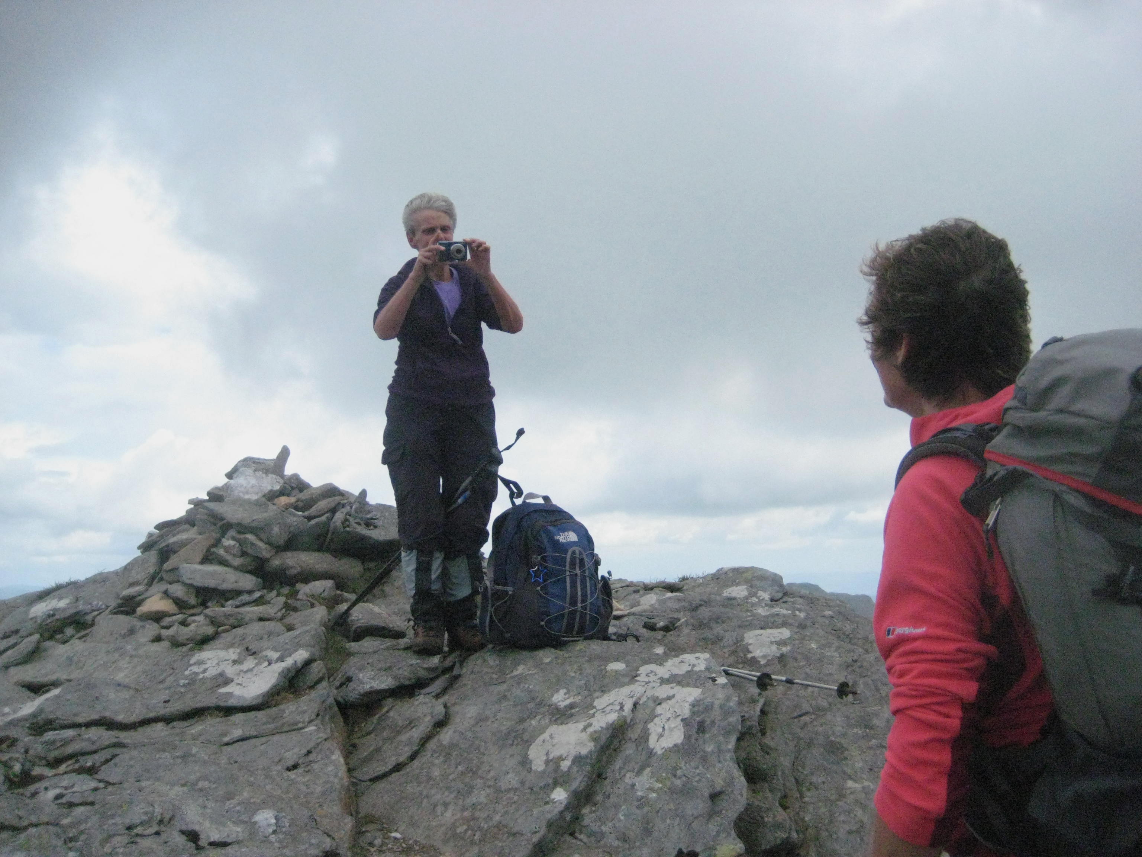

Slide 36
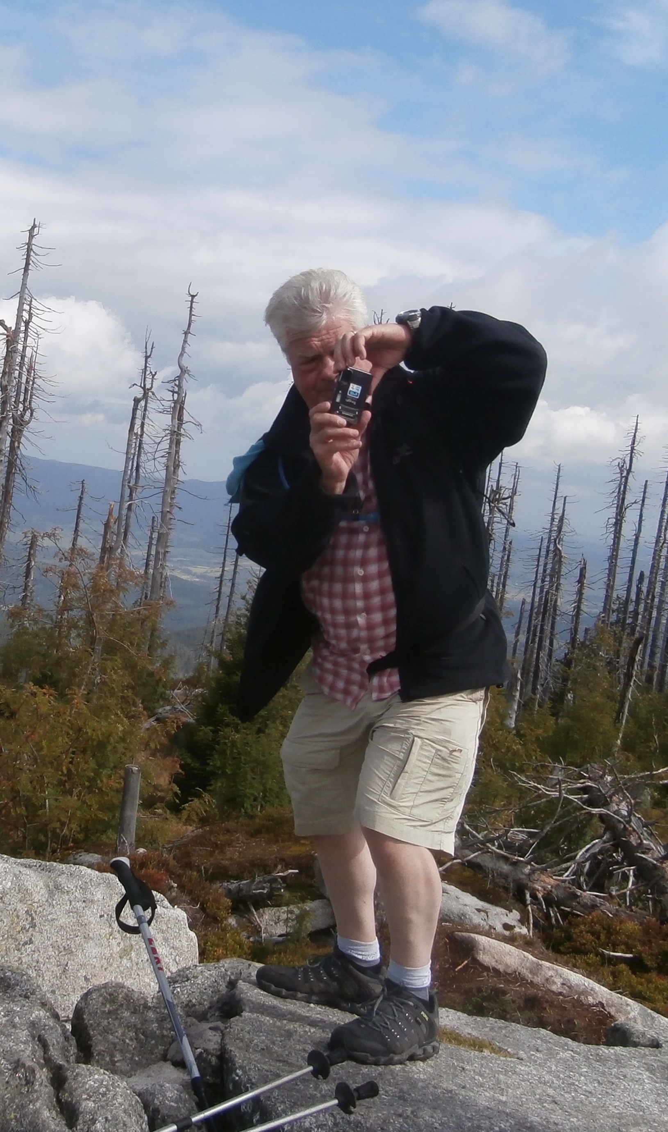

Slide 37
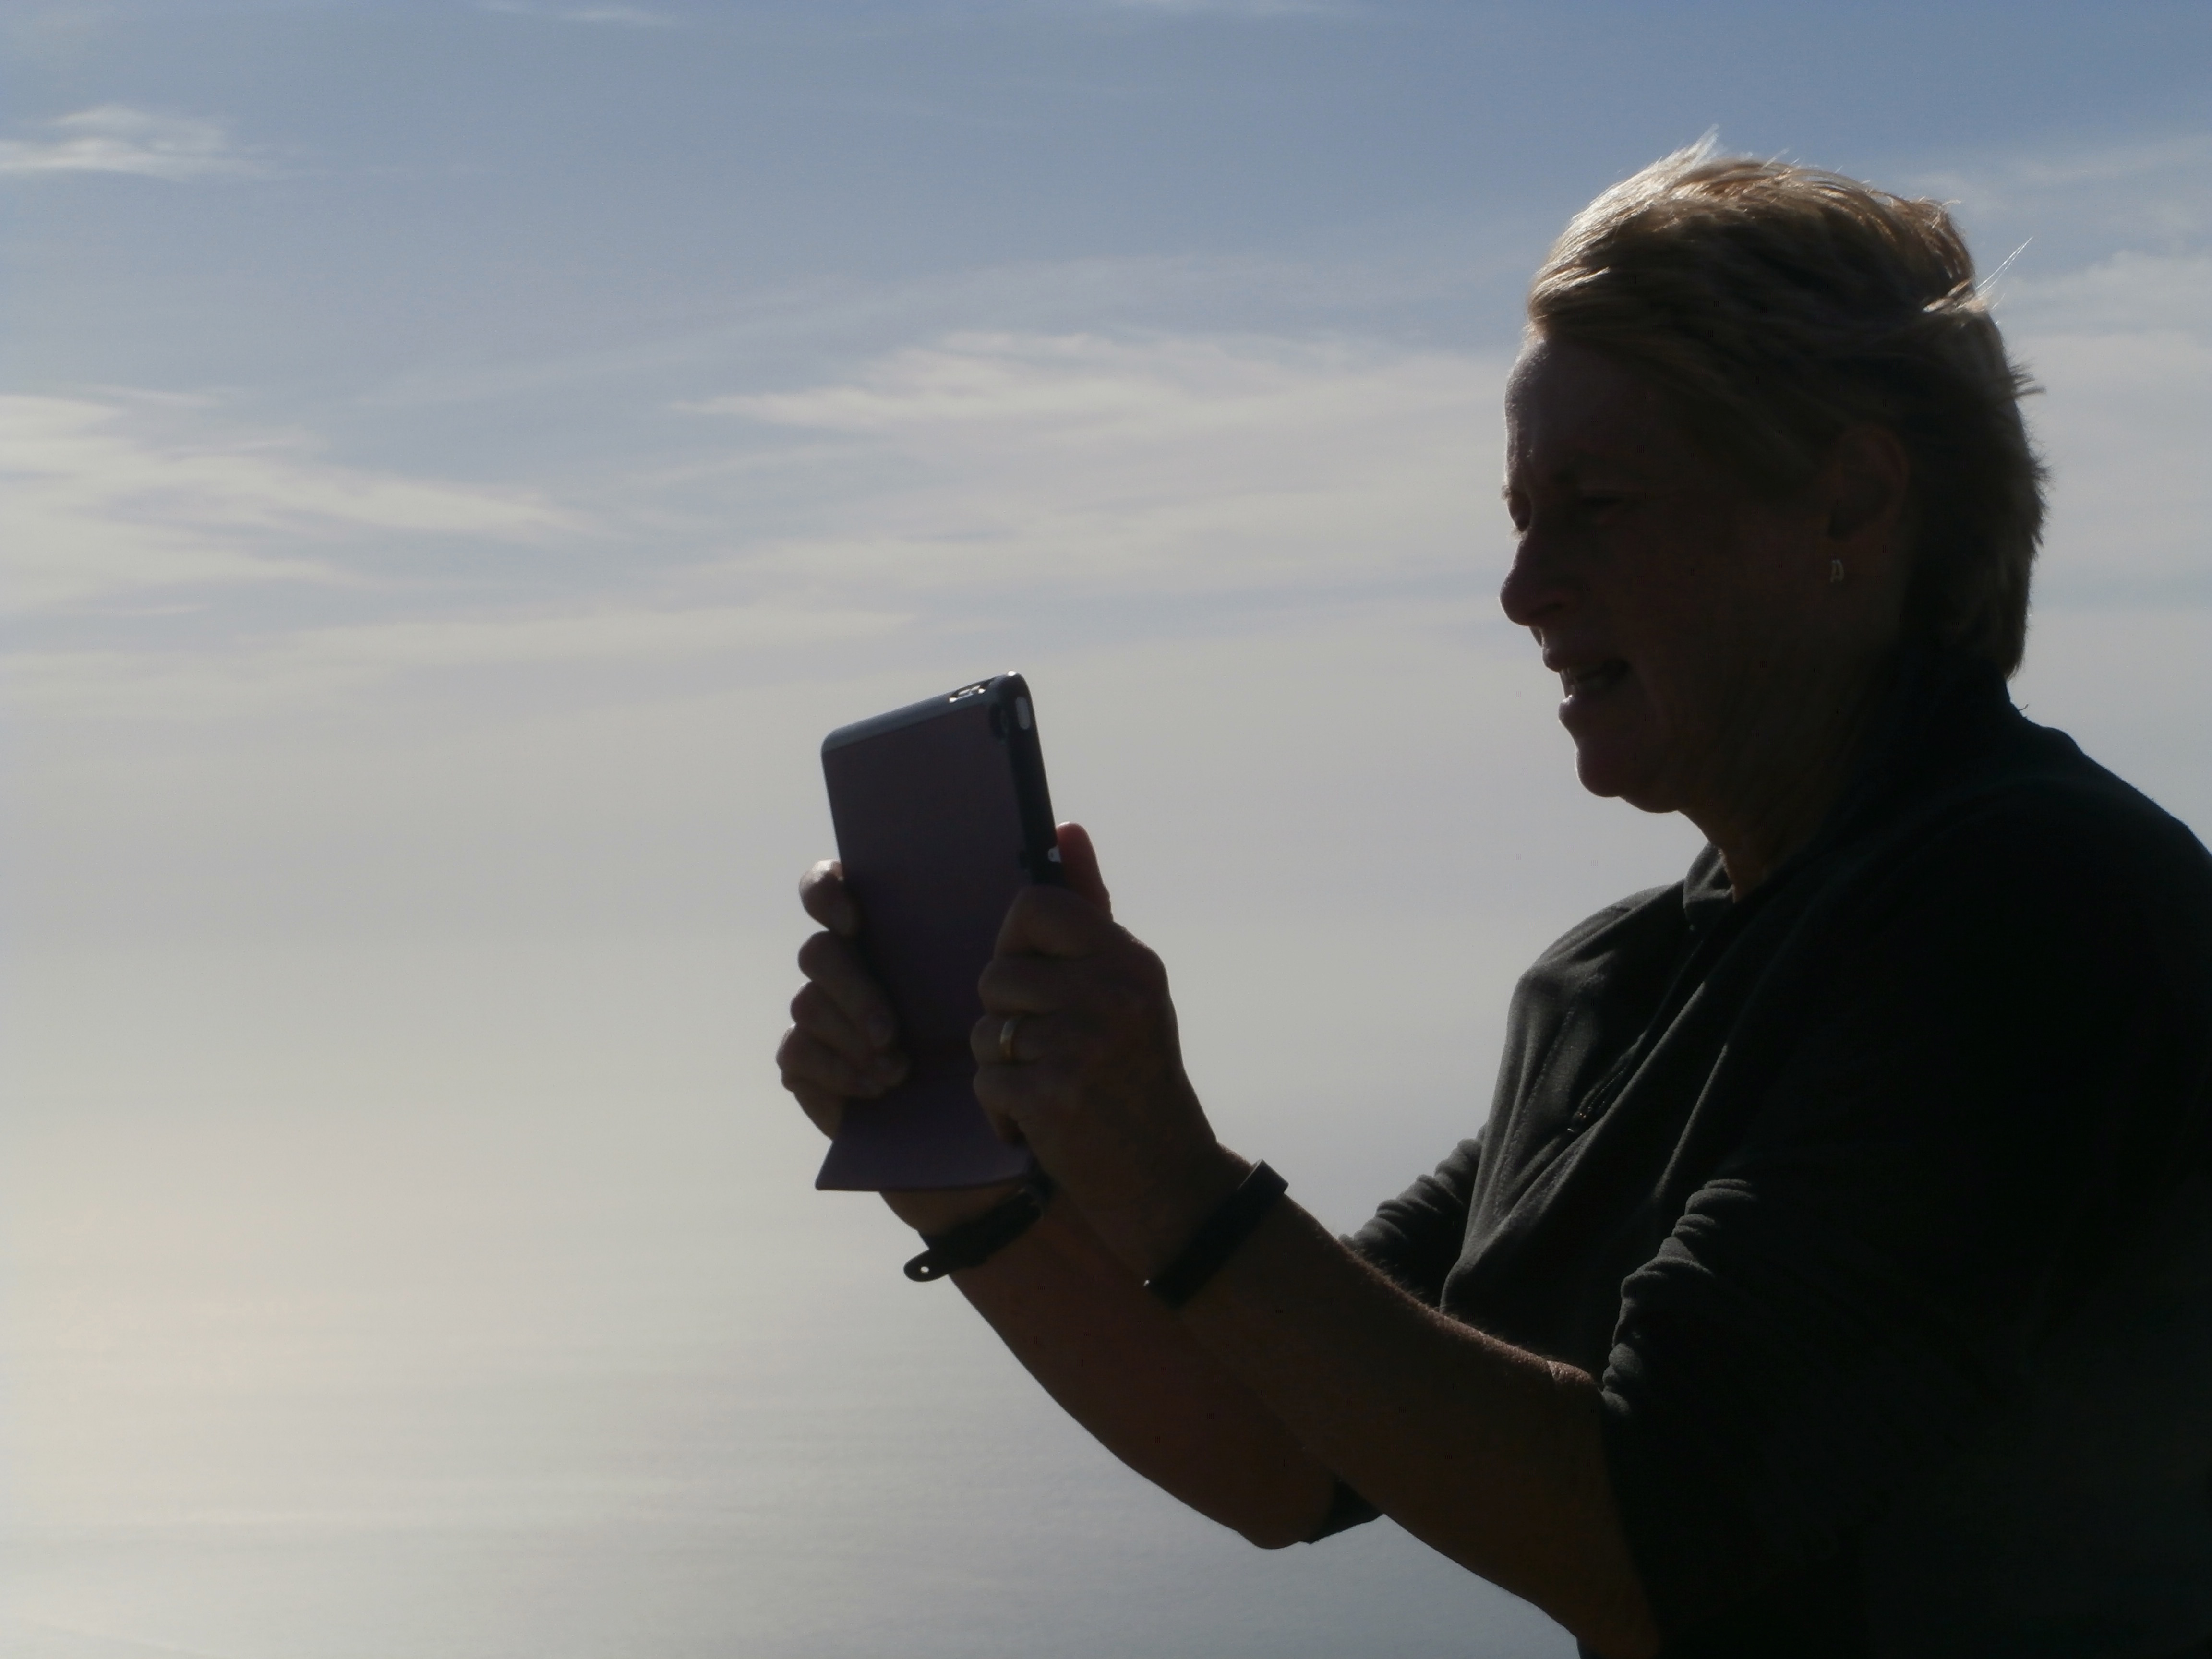

Slide 38
End of Part 6
Photographers

