Slide 1
Bearsden and Milngavie
Ramblers and Hillwalkers
A thematic collection of group’s activities as seen through the lens of
Peter Bartos’ camera from 2006 to 2021
Part 8

Slide 2
Part 8
Trigpoint !
Always a reassuring find ..

Slide 3
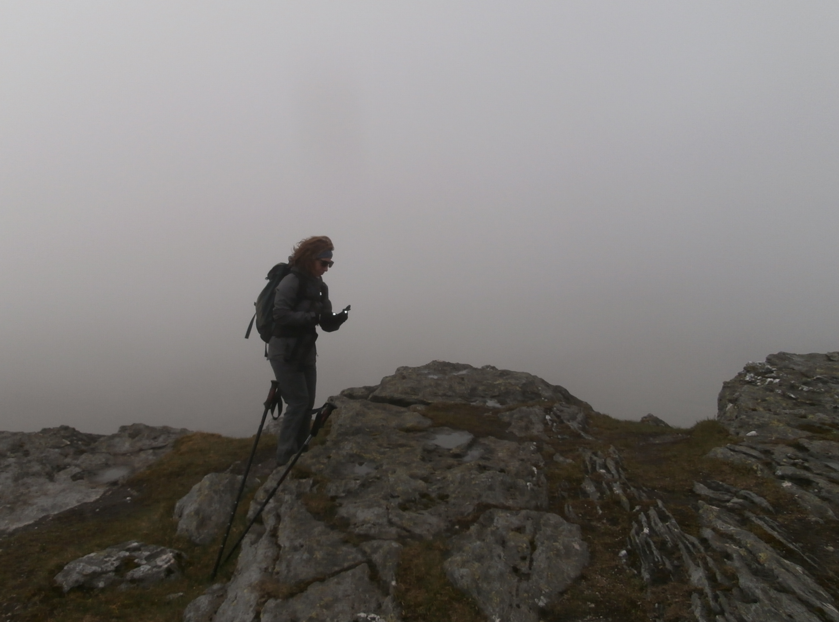
W
The trig point should be here!

Slide 4
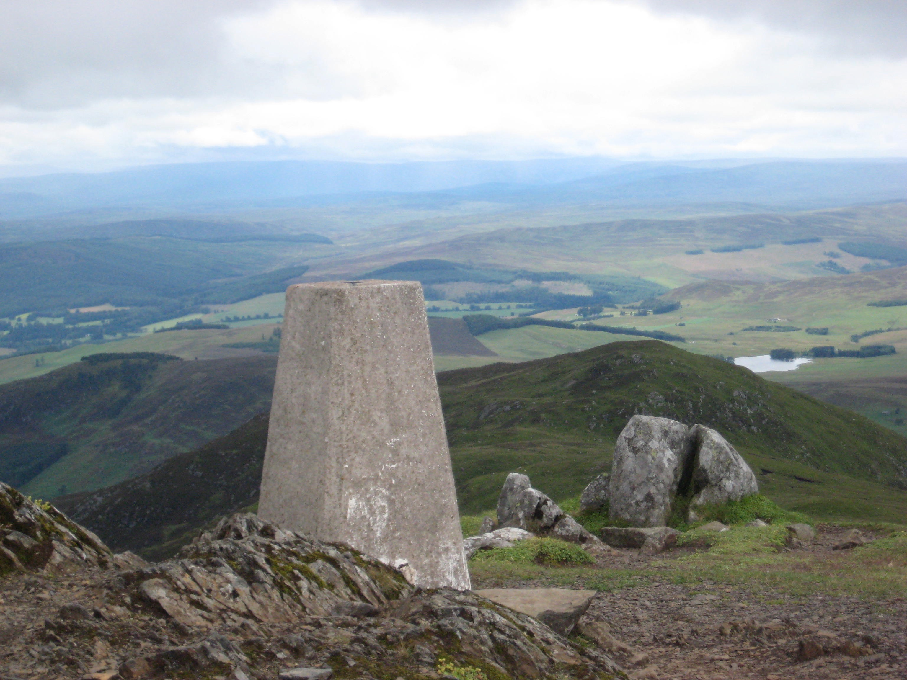
HERE IT IS - but WHERE IS THIS TRIG POINT ?

Slide 5
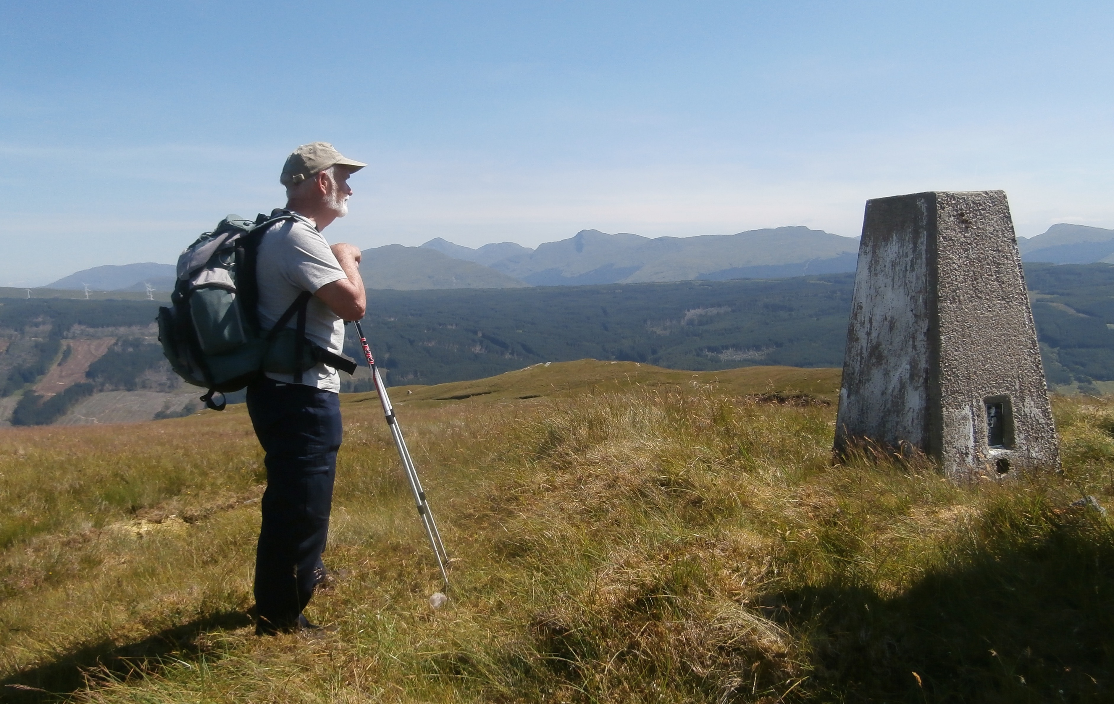

Slide 6
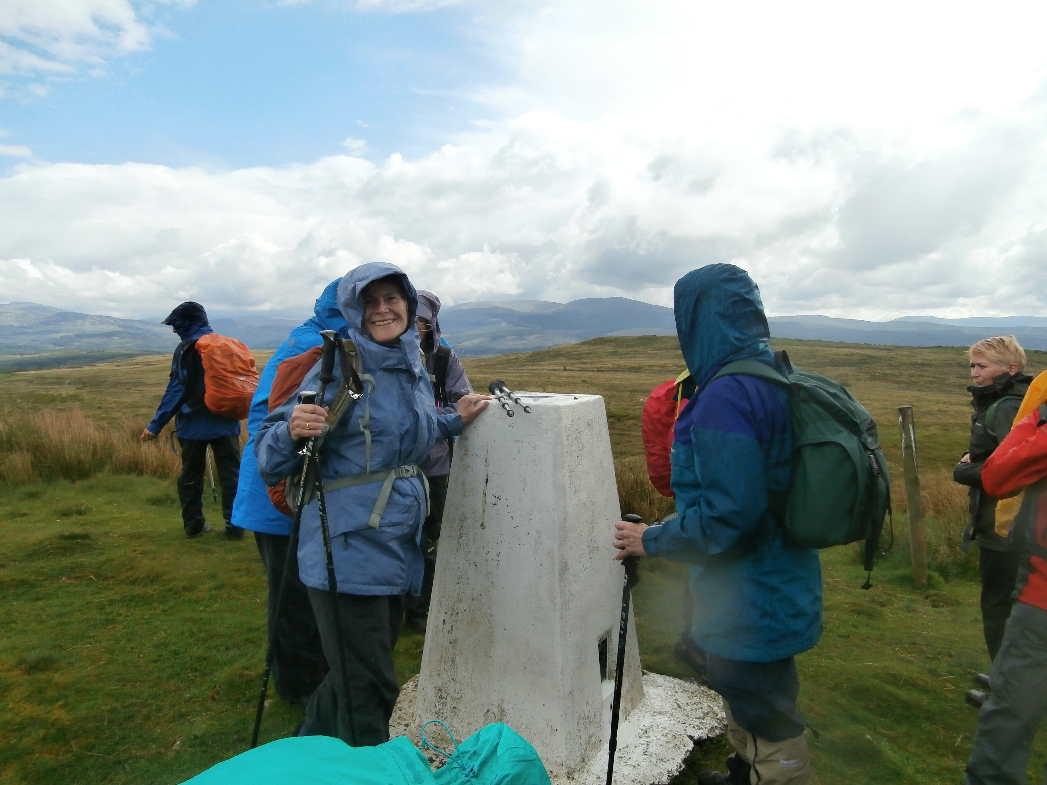

Slide 7
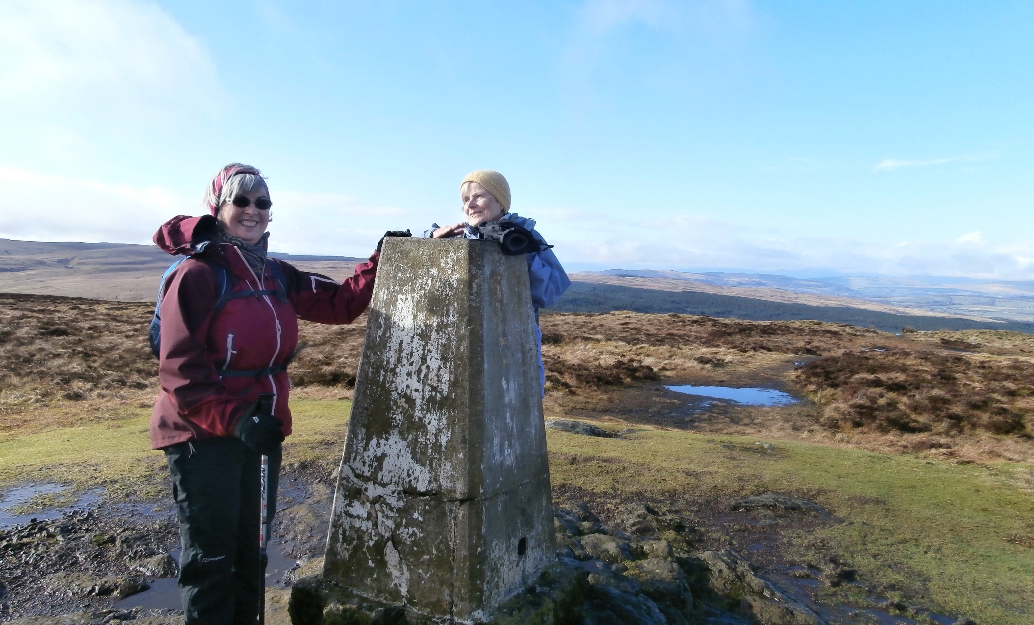

Slide 8
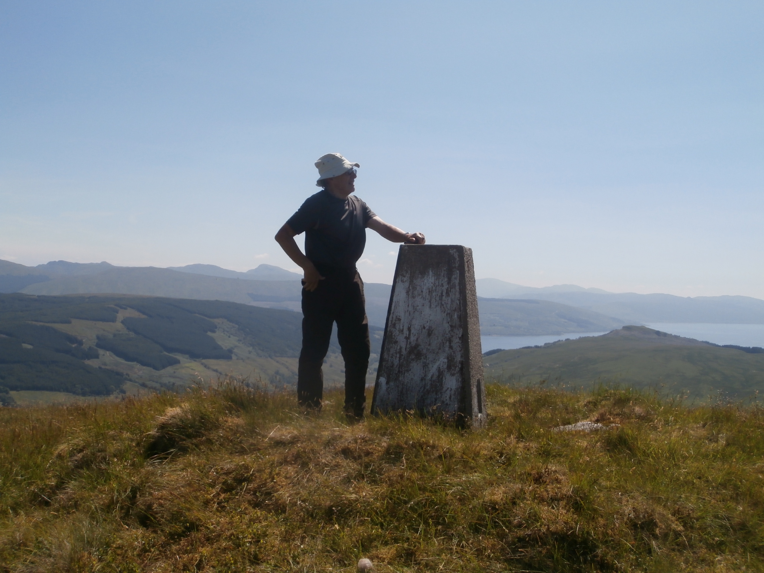

Slide 9
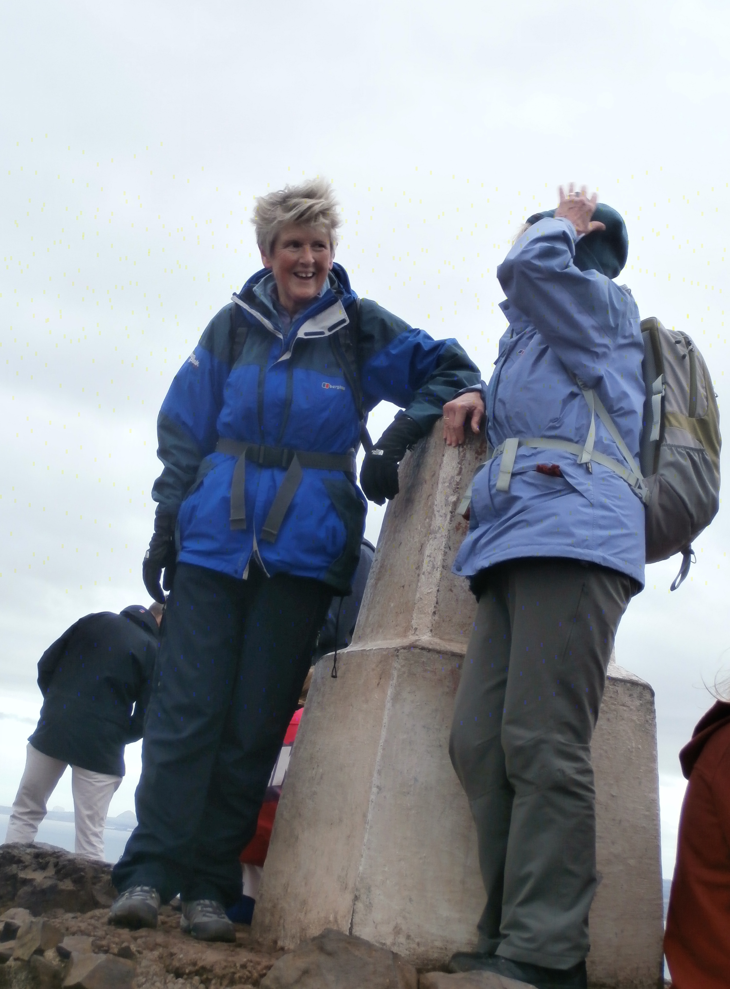

Slide 10
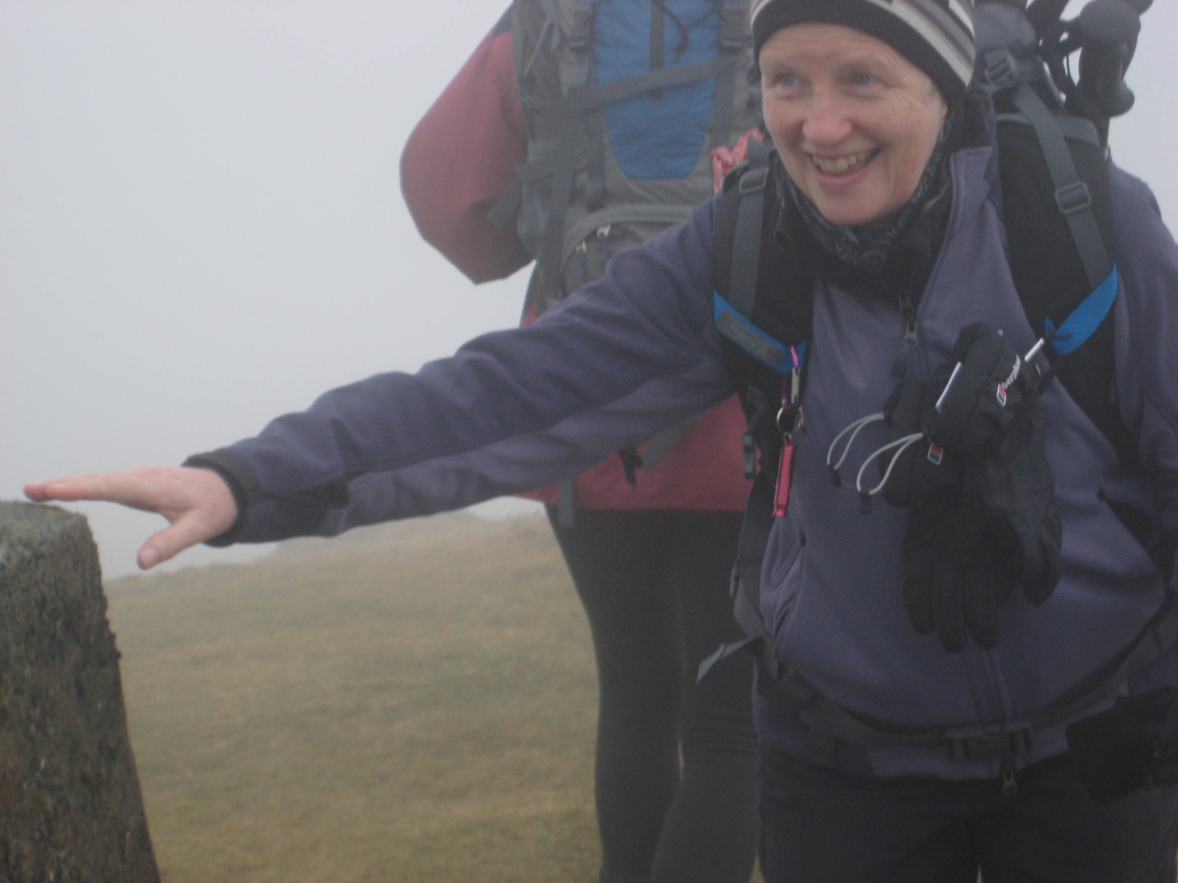
Winner !

Slide 11
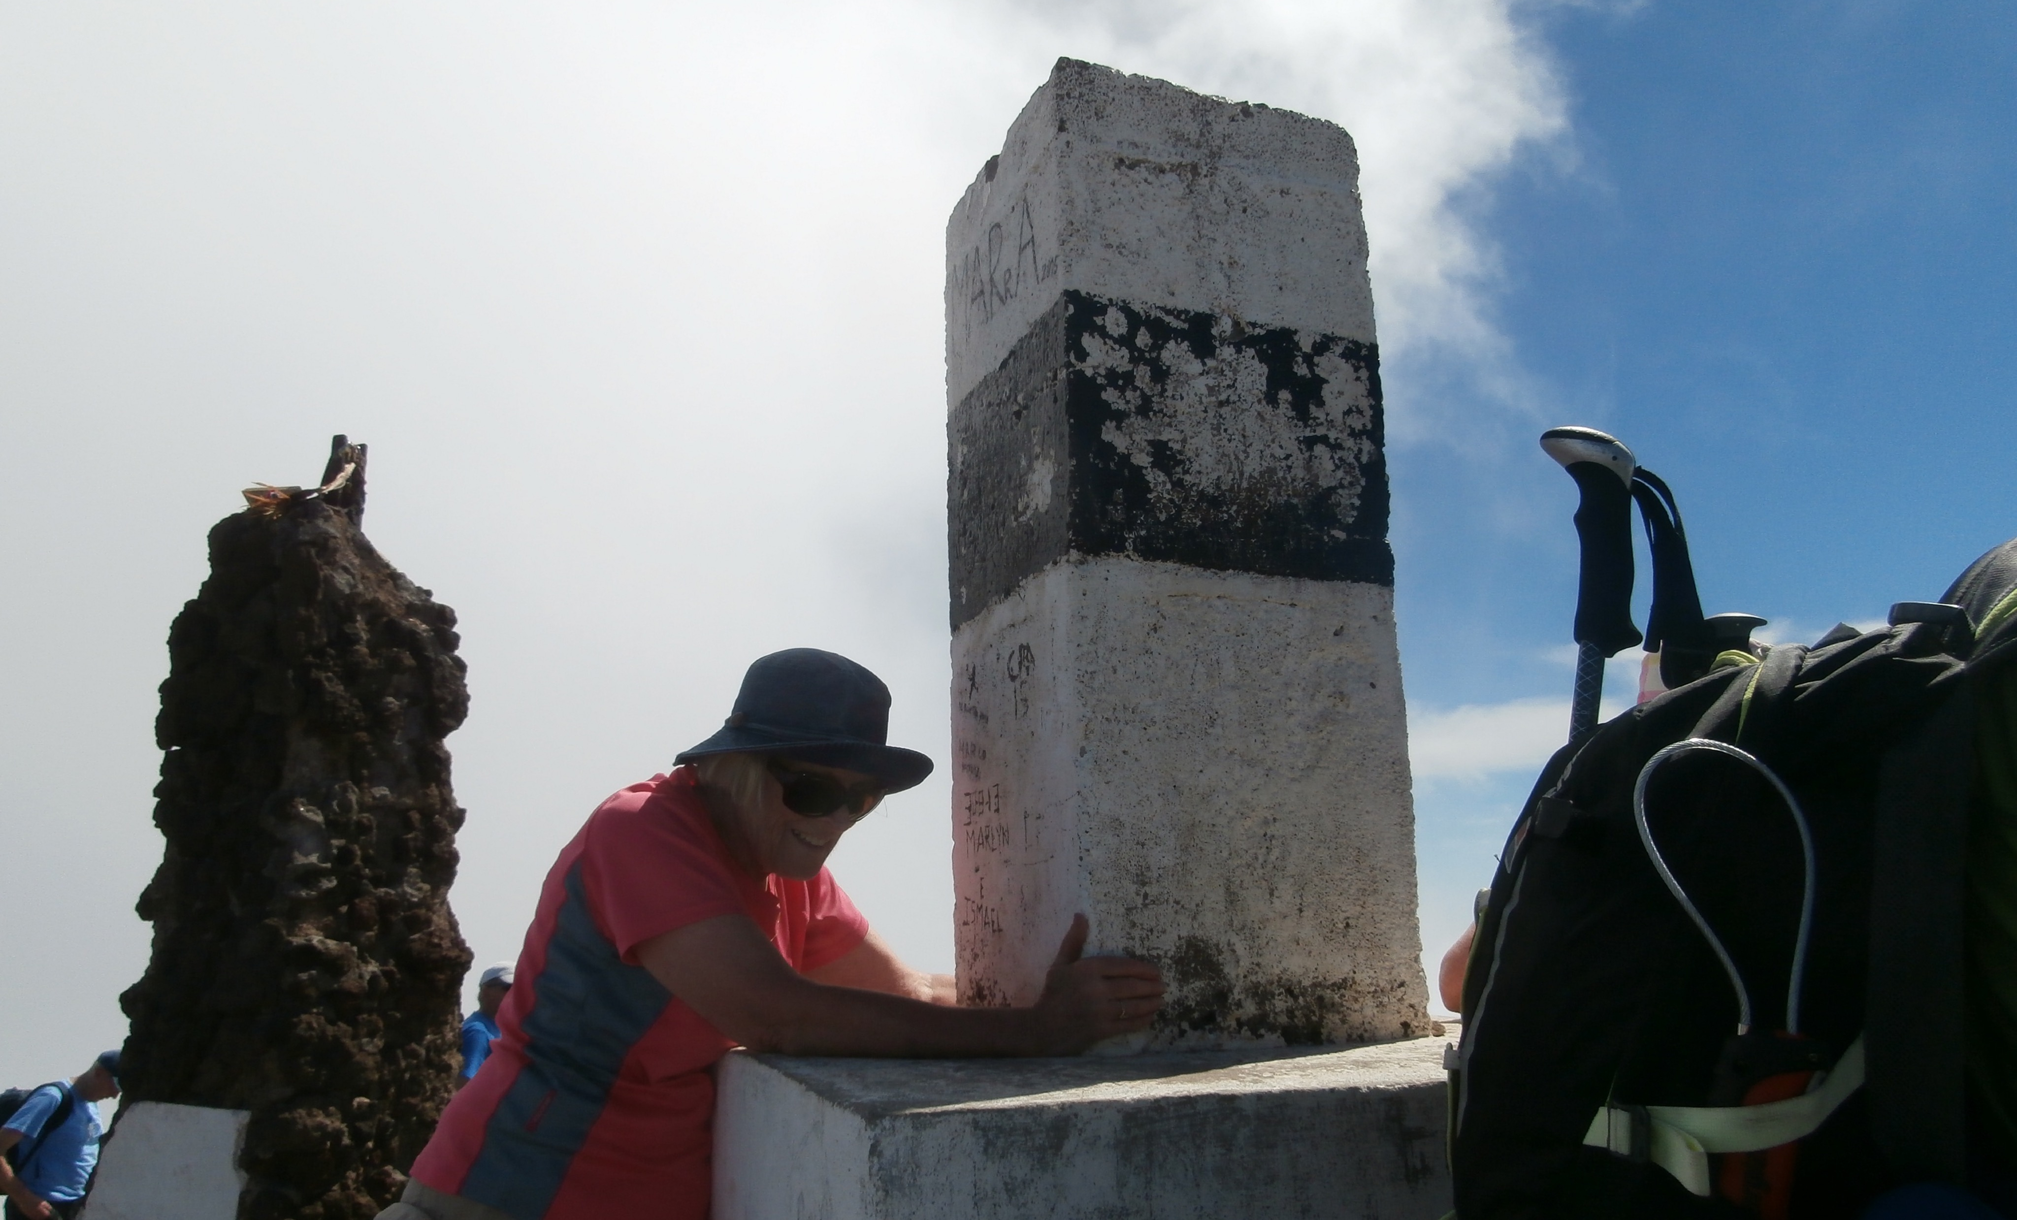

Slide 12
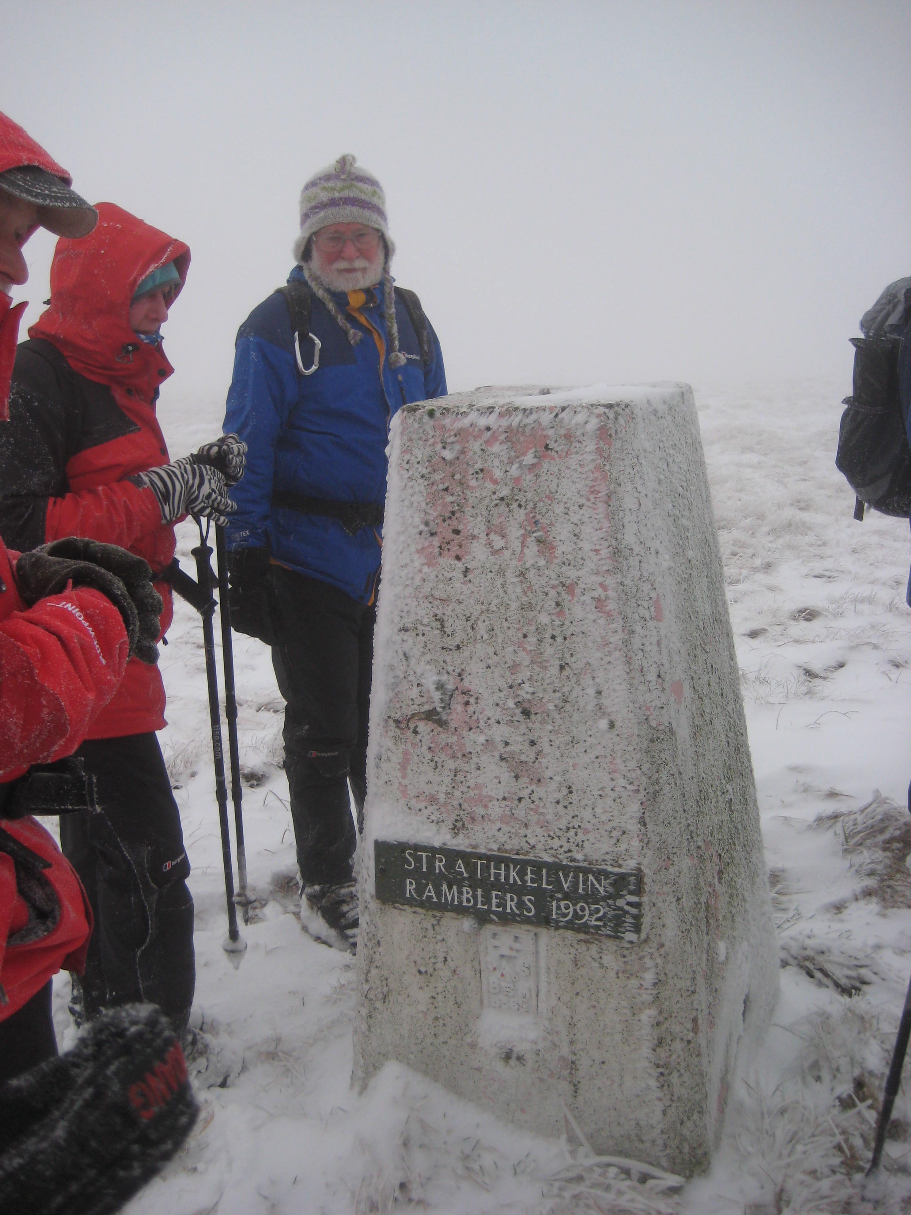

Slide 13
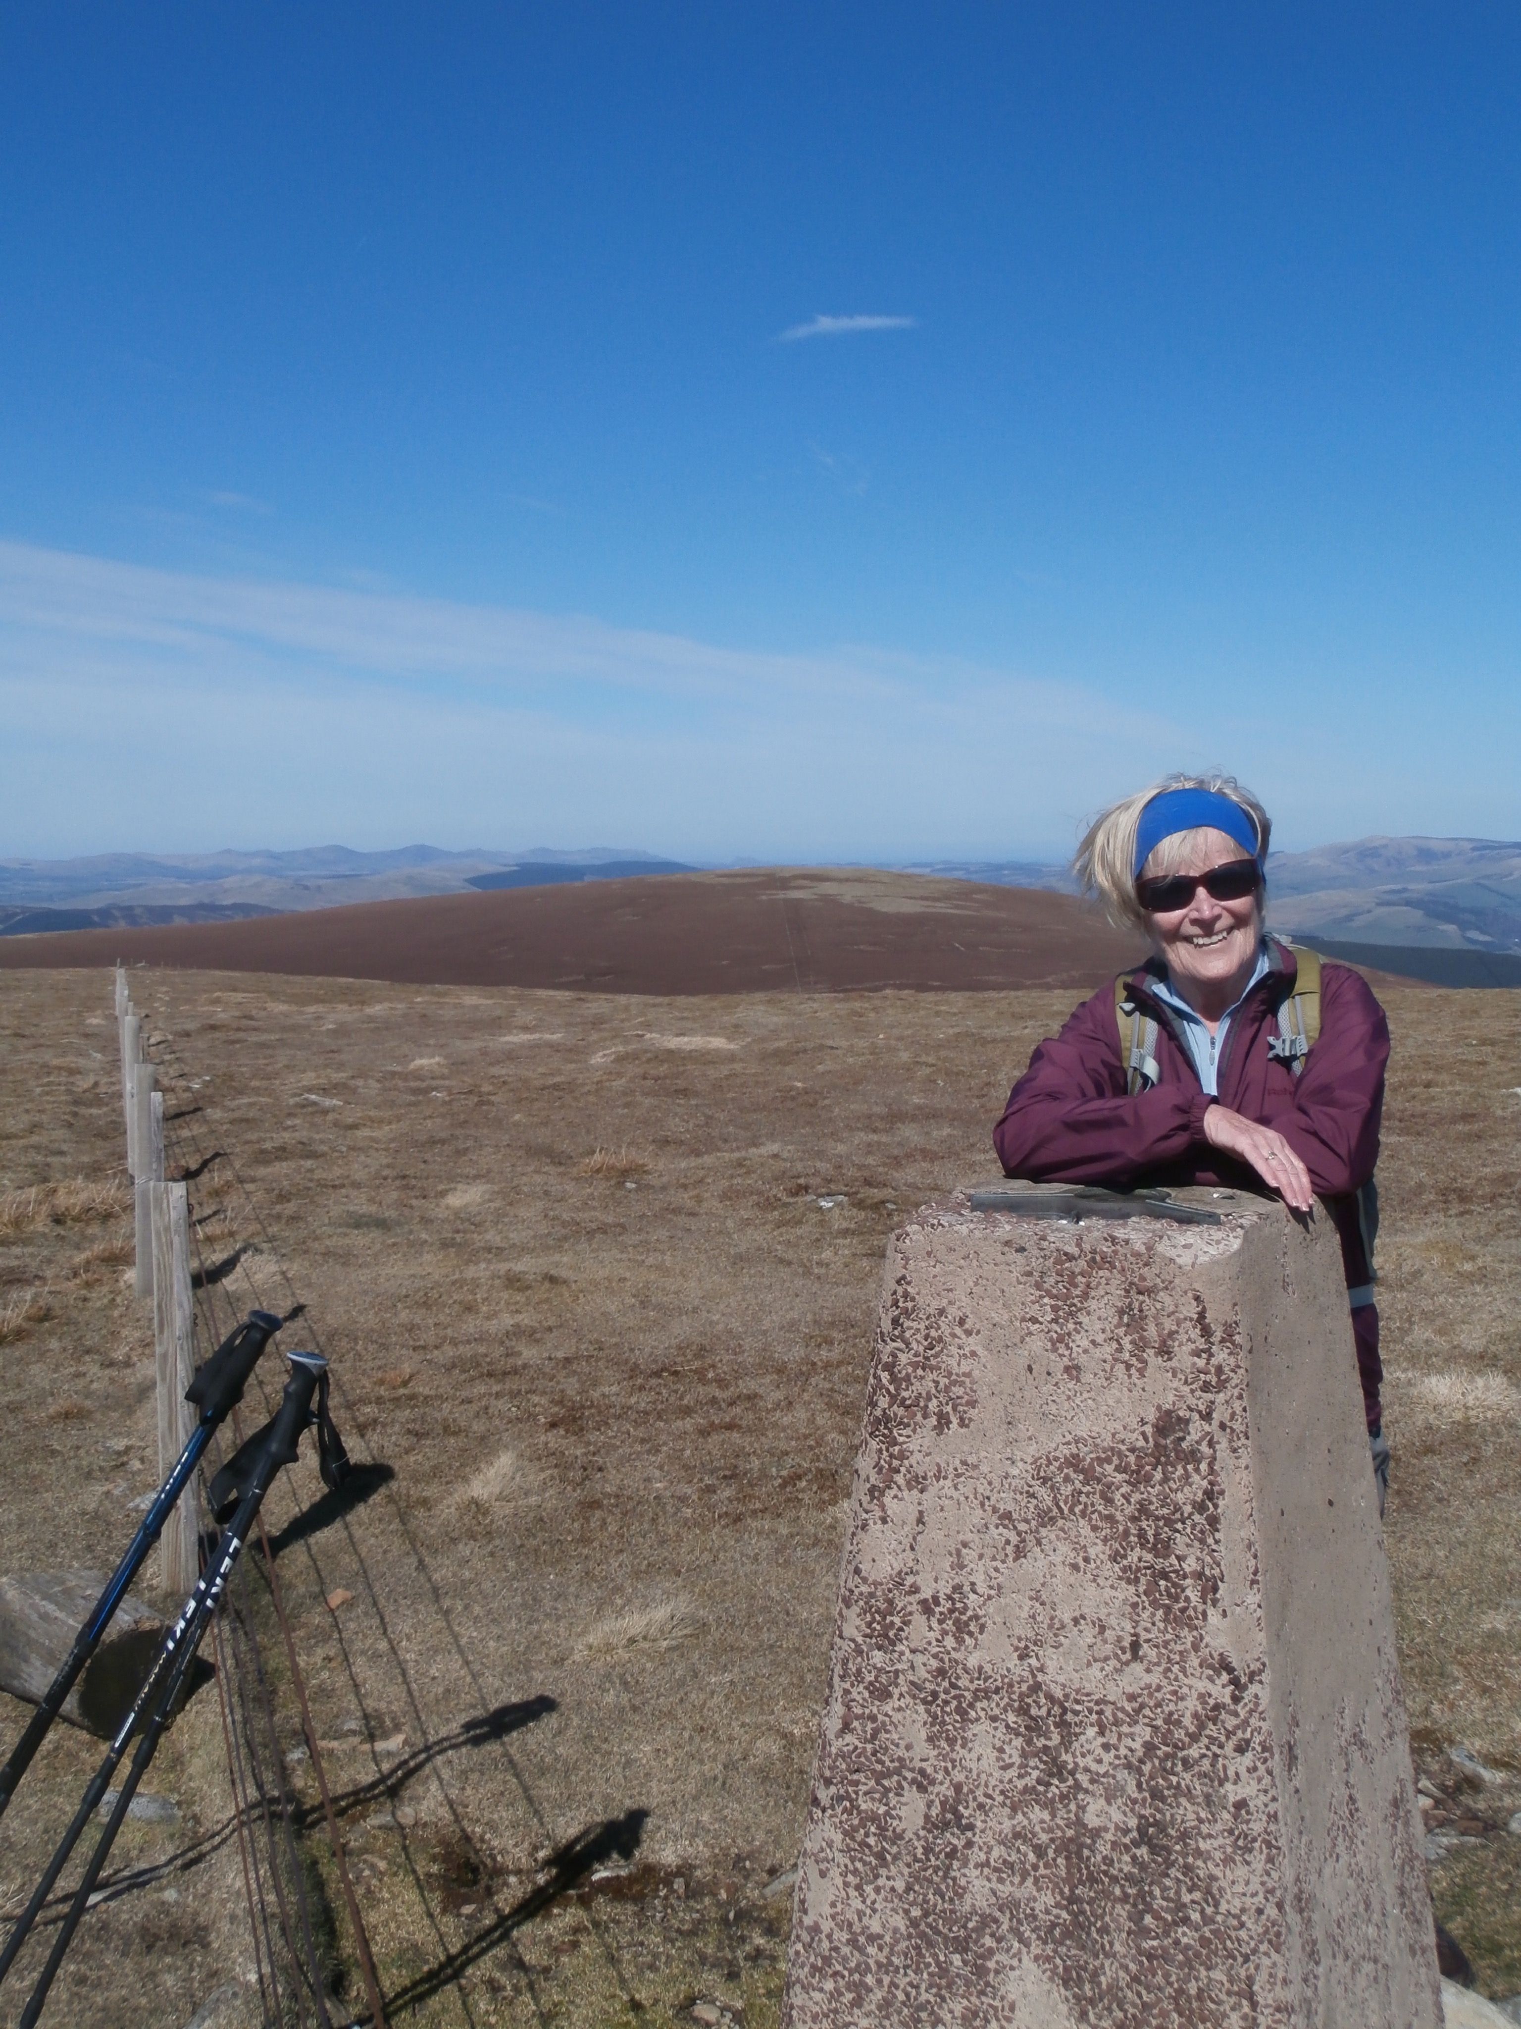

Slide 14
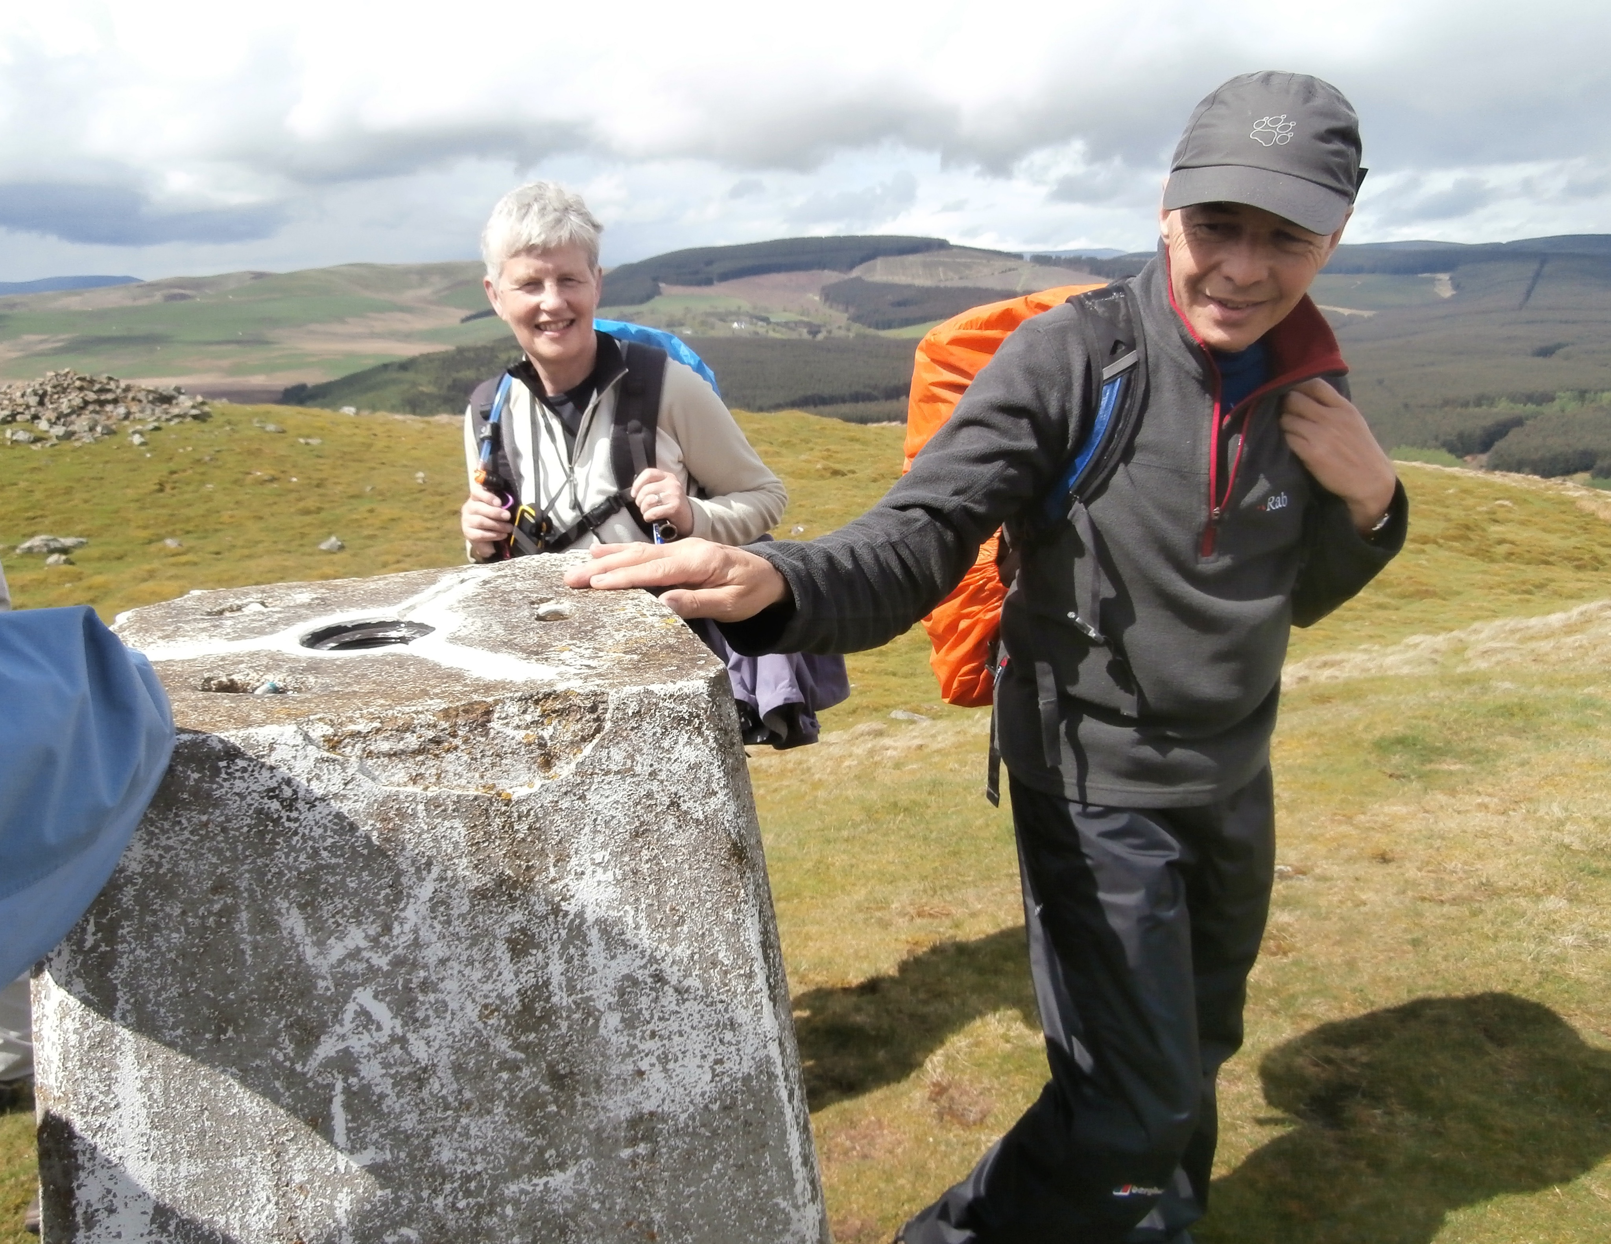

Slide 15
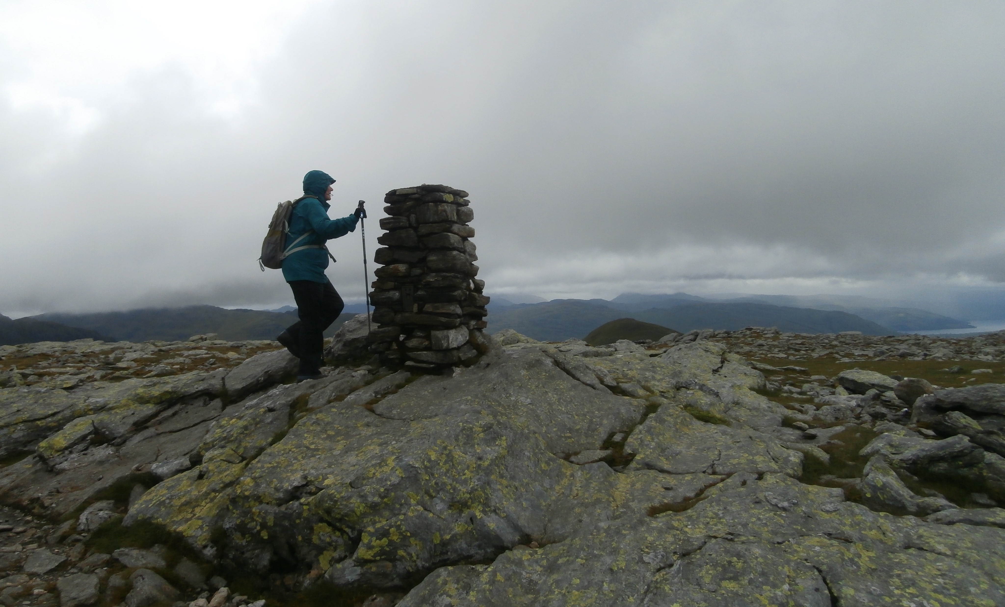

Slide 16
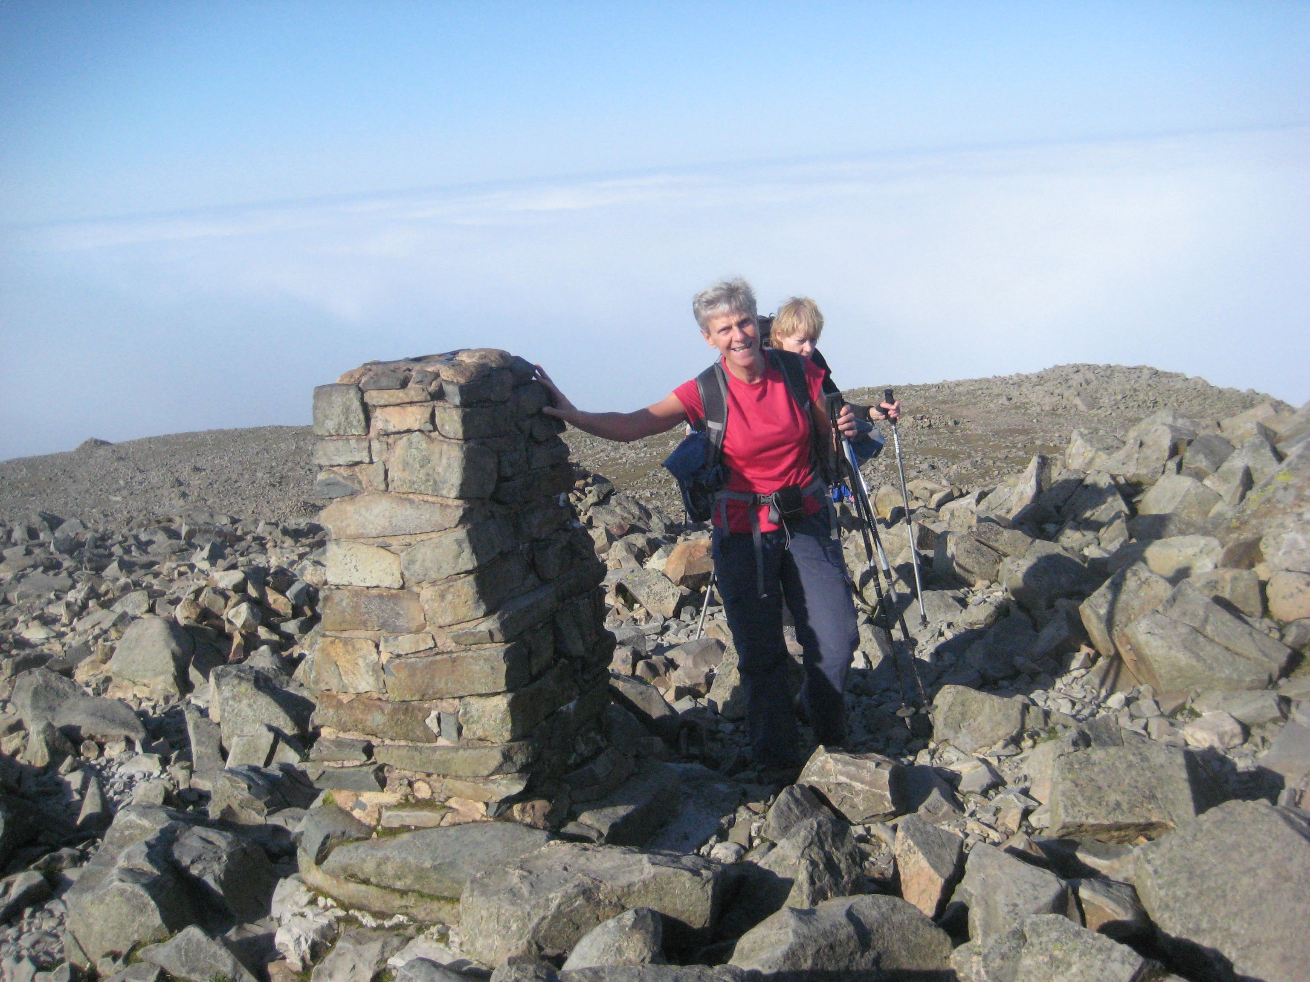

Slide 17
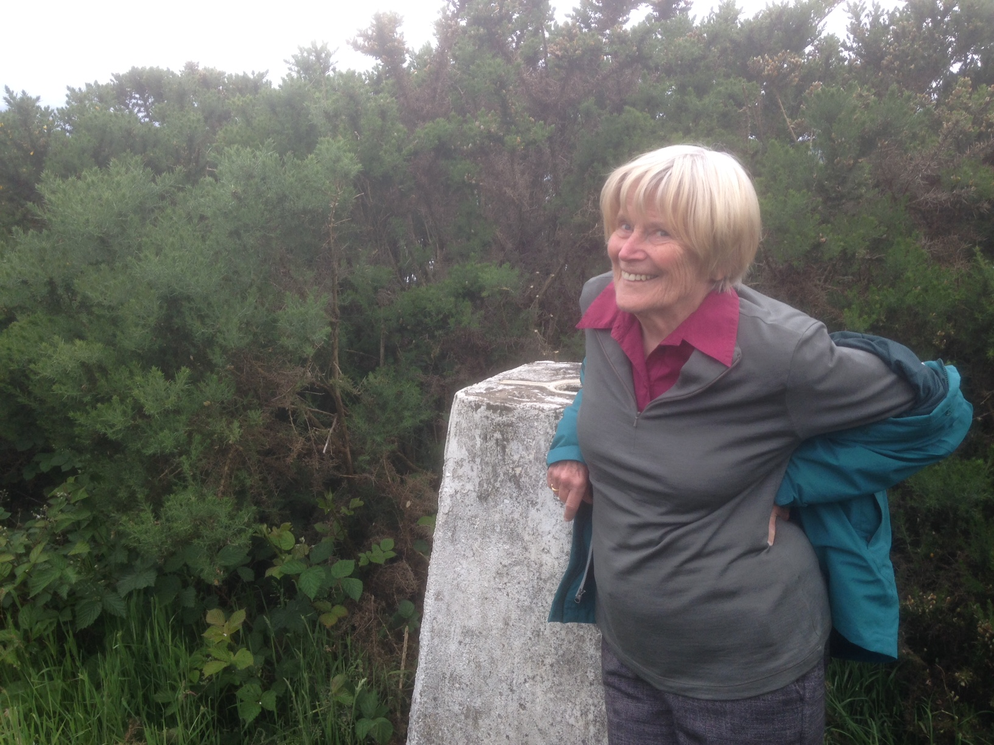

Slide 18
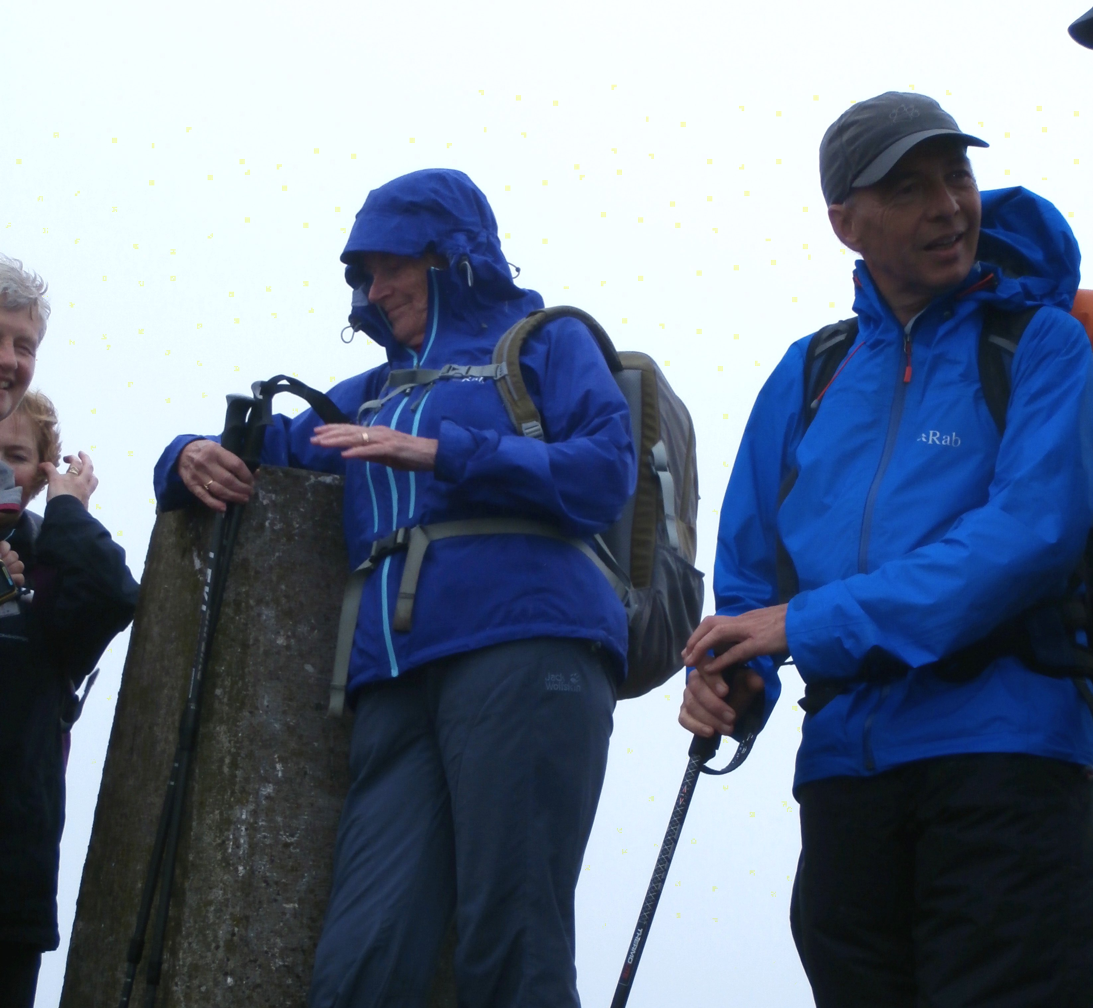

Slide 19
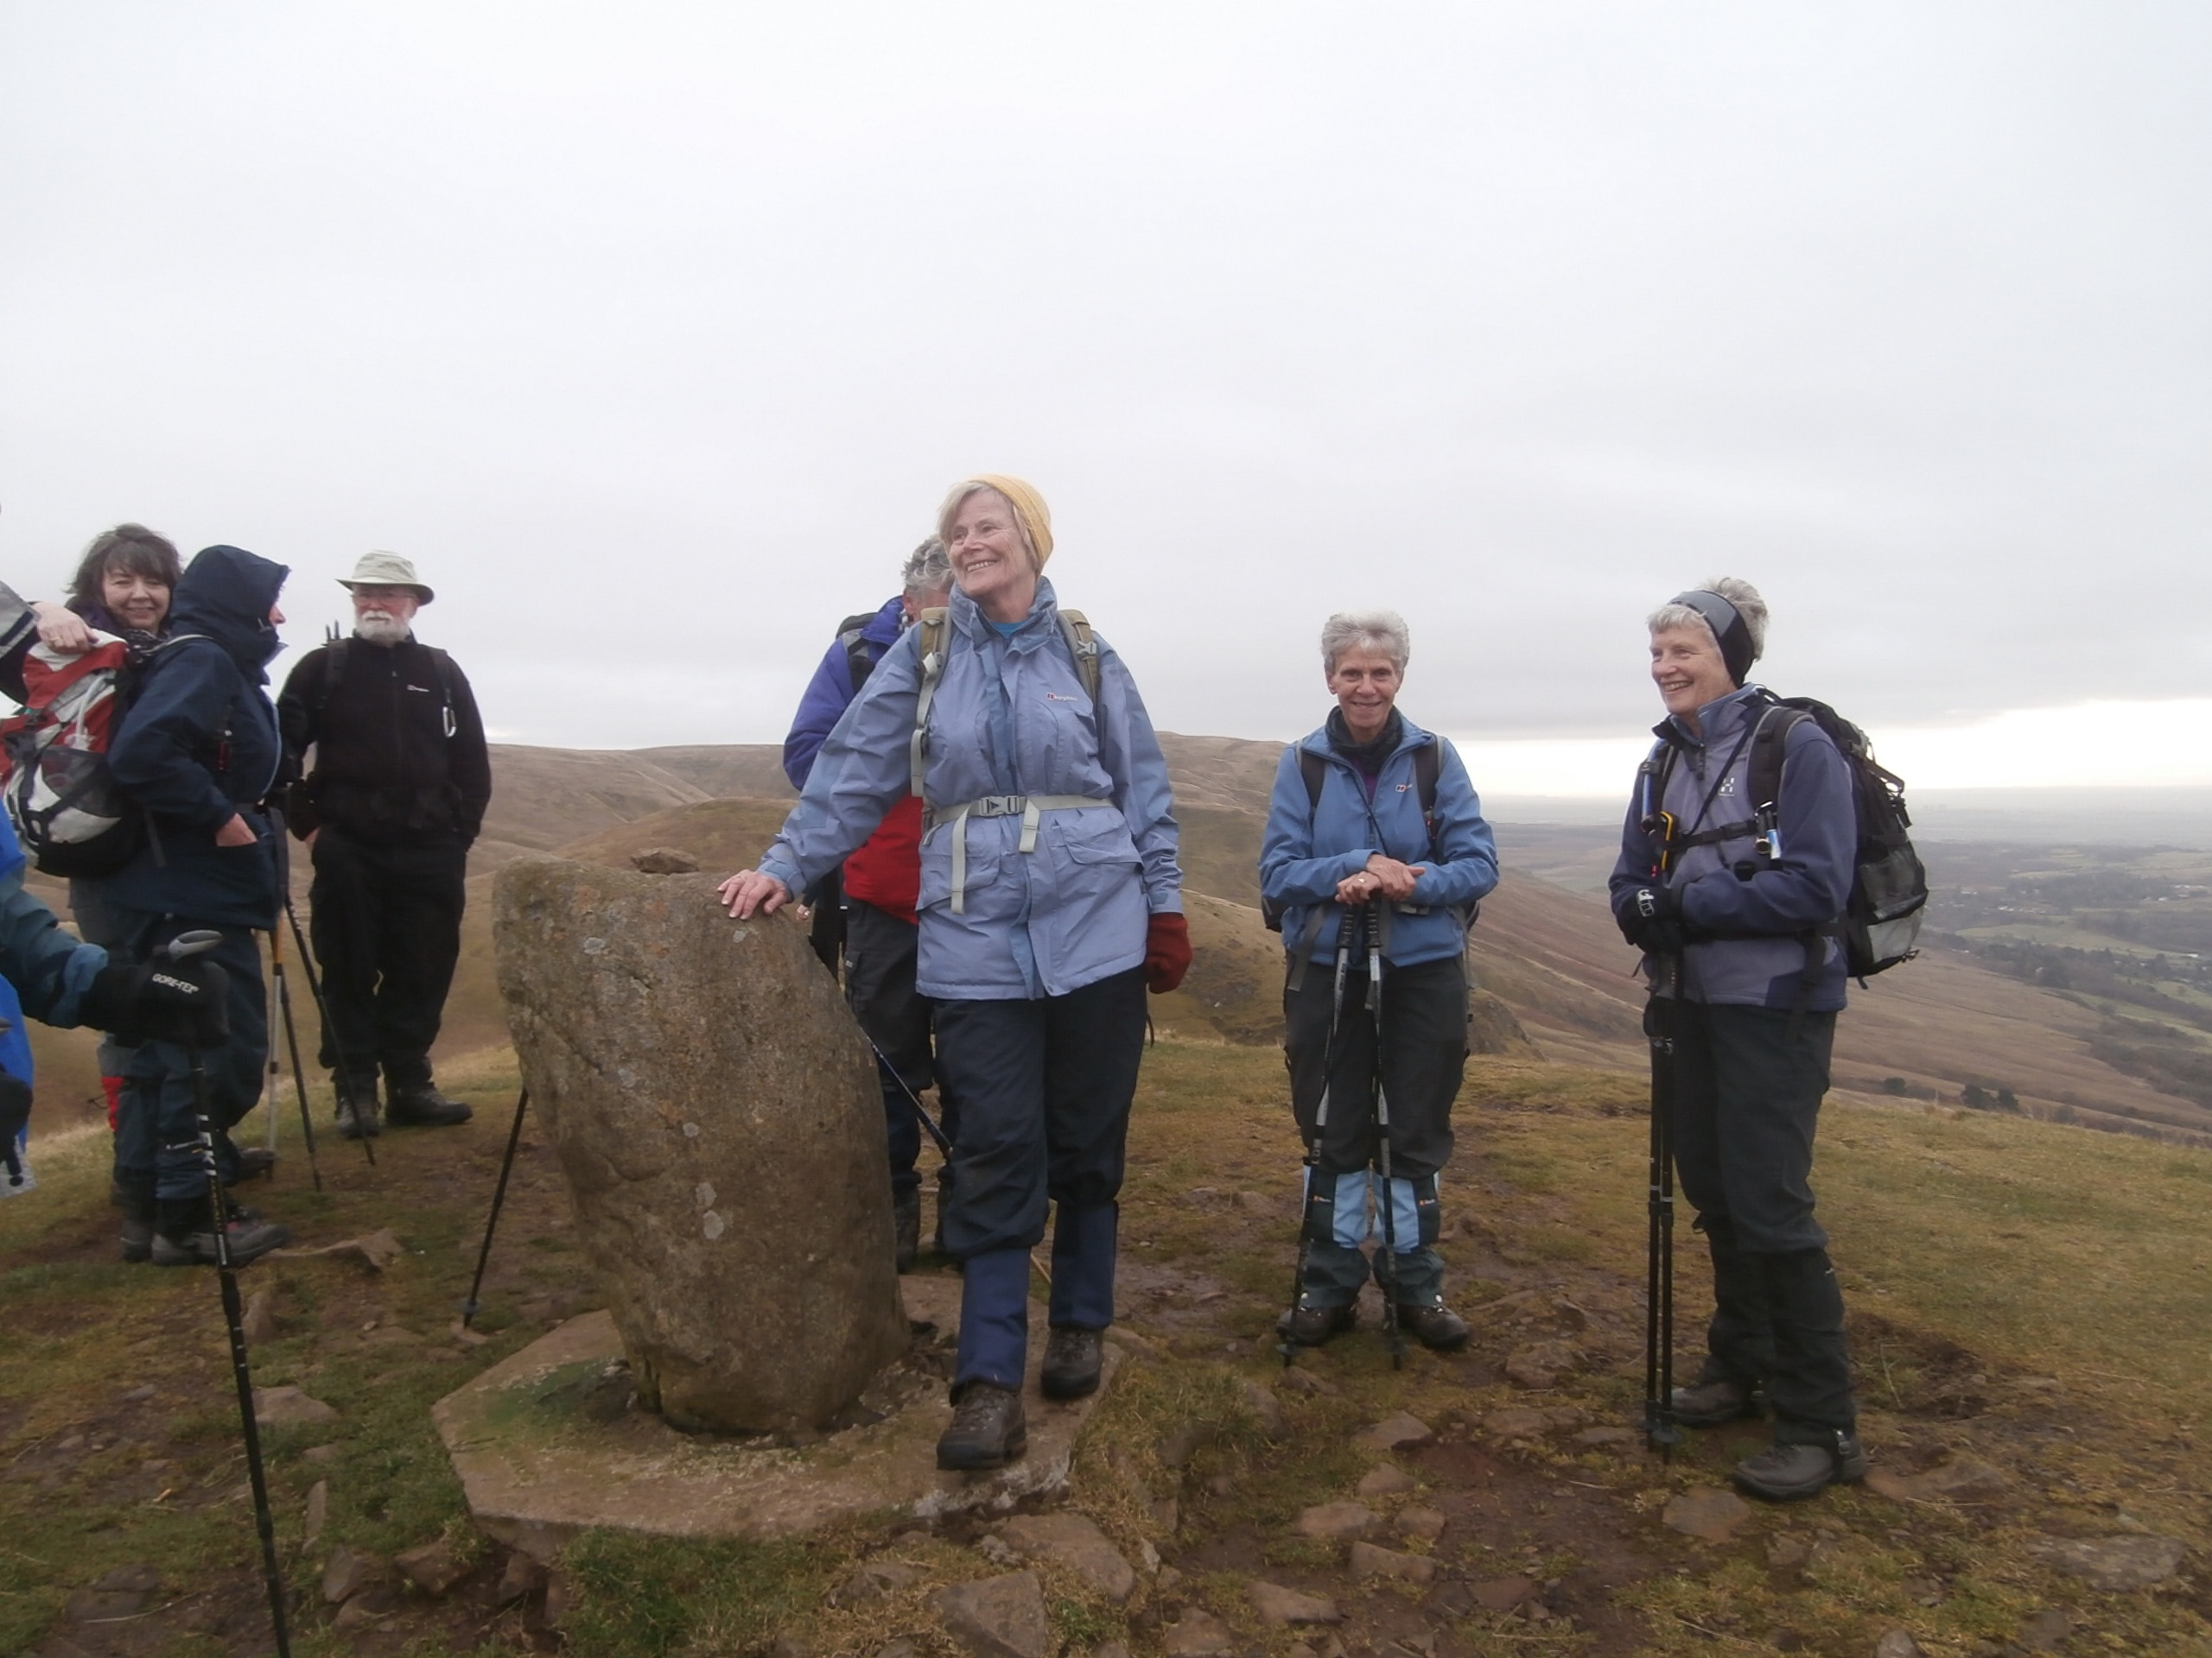
Not a trig point - but it will do …,

Slide 20
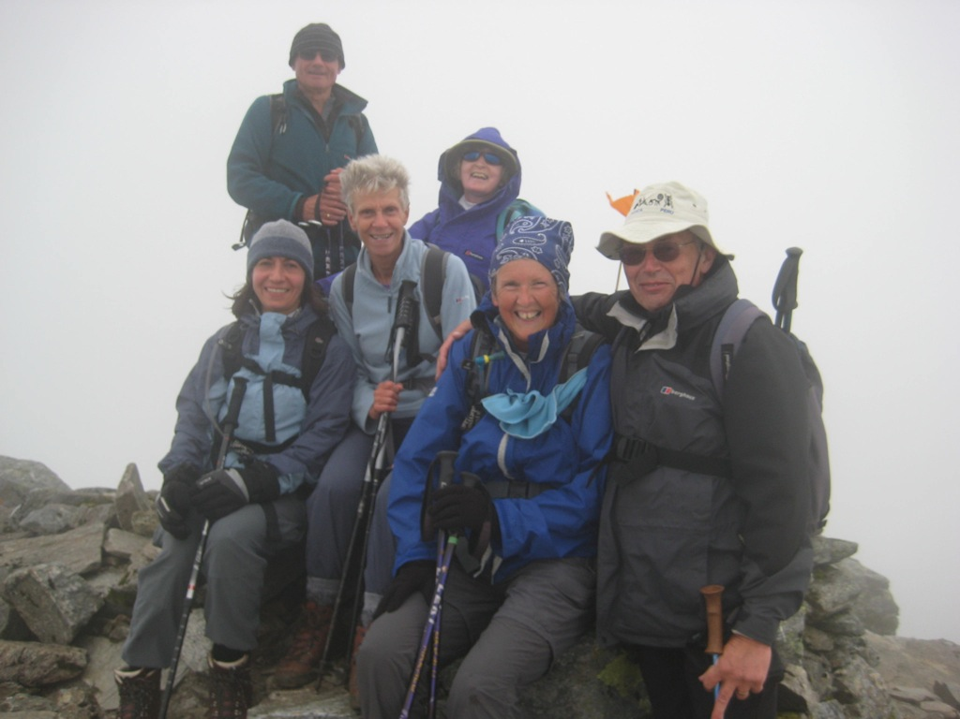
No visibility - but a happy summit party!

Slide 21
Part 8
Trigpoint !
Q1. Which trigpoint was at the lowest altitude
Q2. Which trigpoint was at the highest altitude
Q3.Estimate the altitudes of (1) and (2).
(Questions - optional - answers by email to PB)

